Slide 1
Upper Airway & Bite Considerations for the
Fibromyalgia Patient

Slide 2
Sleep/Breathing/Airway Issues & Jaw/Bite Issues

Slide 3
Sleep/Breathing/Airway Issues & Jaw/Bite Issues

Slide 4
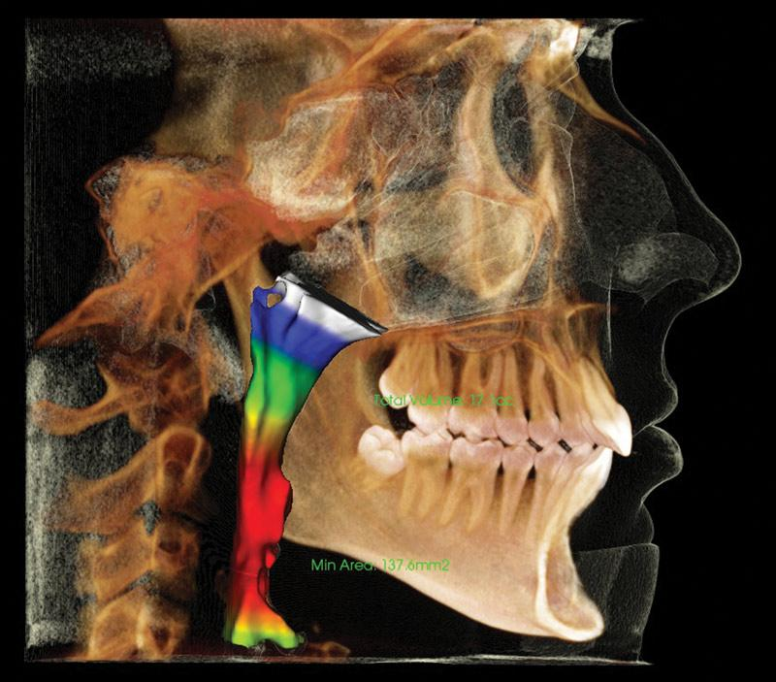
Upper Airway:
Structure & Function
Source: Henry Schein

Slide 5
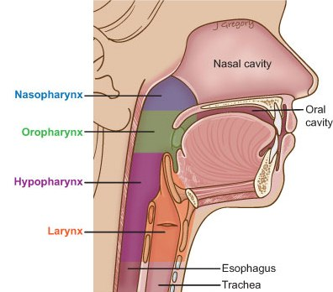
UPPER AIRWAY
The portion of the respiratory tract which is superior to the vocal folds
Nasal cavity
Paranasal sinuses
Oral cavity
Pharynx
Nasopharynx
Oropharynx
Hypopharynx

Slide 6
UPPER AIRWAY
The portion of the respiratory tract which is superior to the vocal folds
Nasal cavity
Paranasal sinuses
Oral cavity
Pharynx
Nasopharynx
Oropharynx
Hypopharynx

Slide 7
Sleep/Breathing/Airway Issues & Jaw/Bite Issues

Slide 8
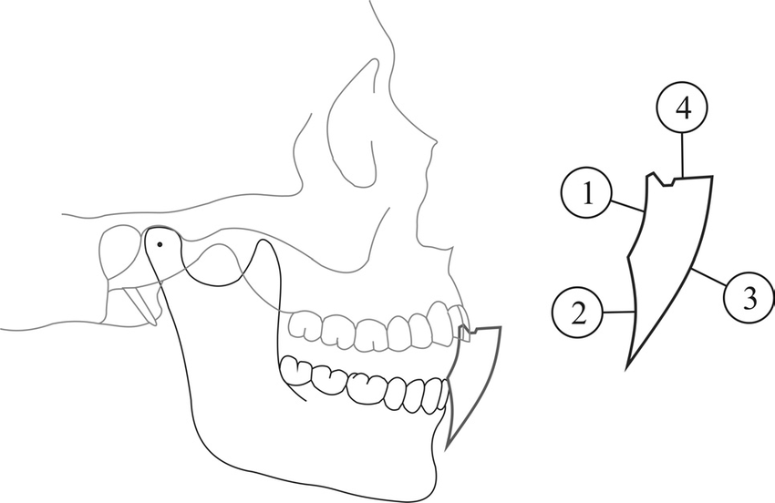
Posselt’s Envelope of Motion
Margielewicz, Jerzy & Chladek, W & Lipski, T. (2008). Kinematical analysis of mandibular motion in a sagittal plane. Acta of bioengineering and biomechanics / Wrocław University of Technology. 10. 9-19.

Slide 9
Constricted Envelope of Function
"Dental" Envelope of Function… [is] the pathway of mandibular movement created by the contours of the teeth.
– Dr. Greg Kinzer
Facially Generated Treatment Planning: What is the ideal position of the central incisor in three planes of space? Spear Educatoin. Rebecca Bockow , November 11, 2017.

Slide 10
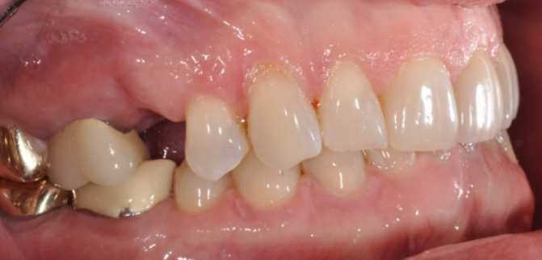
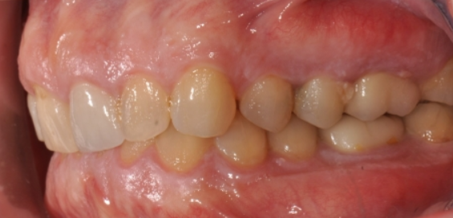
Constricted Envelope of Function
“Upright or retrusive incisors contribute to excessive wear and can lead to a restricted envelope of occlusal function. Retrusive maxillary incisors restrict the movement of the mandible as they guide the arc of mandibular closure posteriorly.”
– Dr. Rebecca Bockow
Facially Generated Treatment Planning: What is the ideal position of the central incisor in three planes of space? Spear Educatoin. Rebecca Bockow , November 11, 2017.

Slide 11
Orthodontic & Orthopedic Treatment Modalities
Structural
Dental Changes
Jaw Orthopedics
Surgical
Non-surgical
Functional
Oral Sleep Appliances

Slide 12
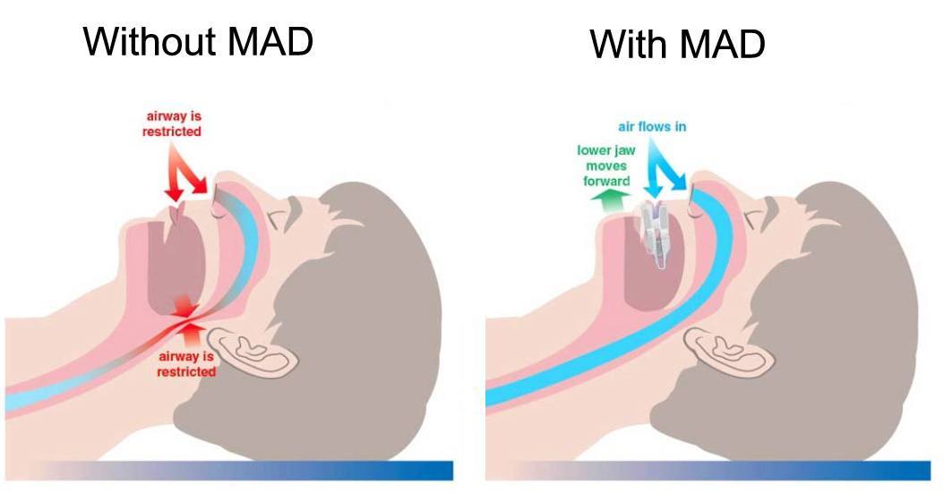
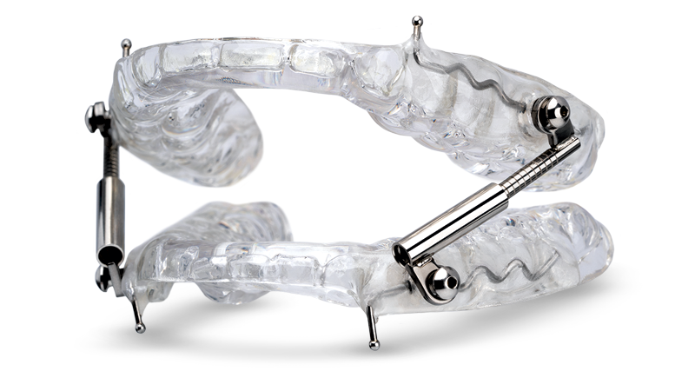
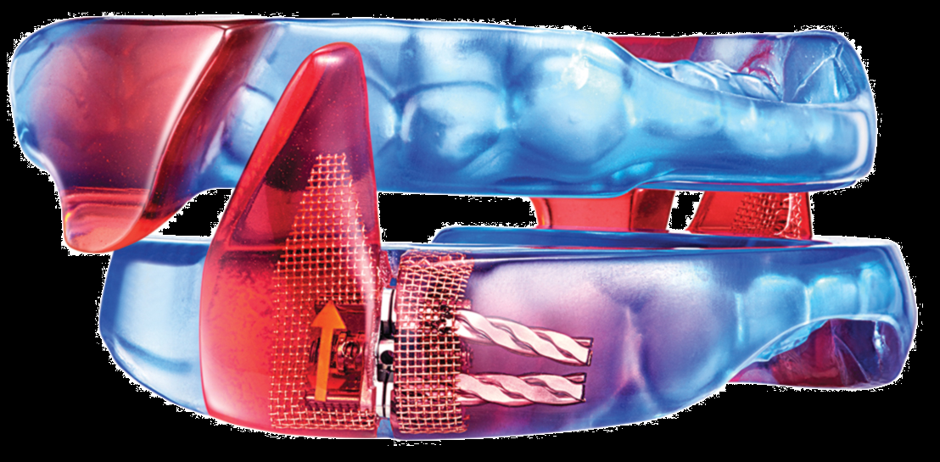
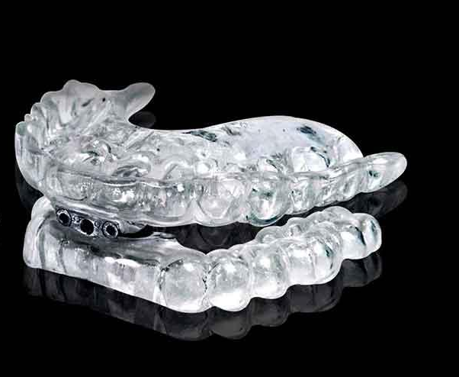
Mandibular Advancement Device
(MAD)
Advantage
Non-invasive
Disadvantages
Only for sleep time
Compliance
TMD
Management strategy, NOT A CURE
Move teeth

Slide 13
Treatment Modalities: MAD
Photos Credit: Dr. Joseph Yousefian

Slide 14
Case 1: Henley

Slide 15
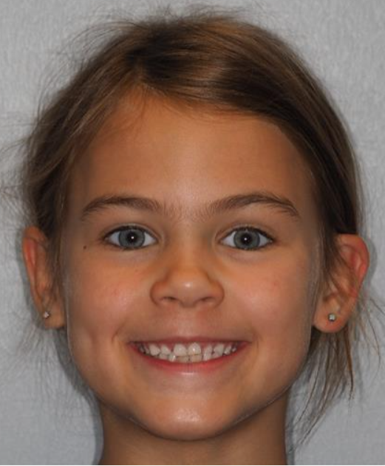
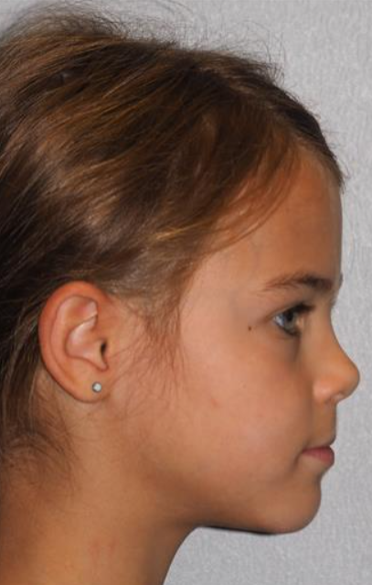
Treatment Modalities: Pediatric Orthopedics
Henley
6 y/o F
Chief Concern: “crowding, crossbite”
Restless sleep
Frequent ear infections
Slight skeletal Class III tendency

Slide 16
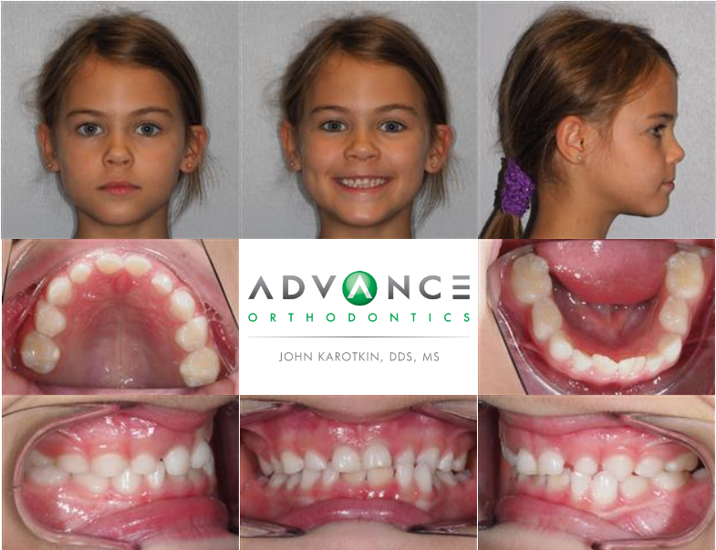
Treatment Modalities: Pediatric Orthopedics & Orthodontics

Slide 17
Treatment Modalities: Pediatric Orthopedics
Plan
U&L expanders
Protraction face mask
U&L limited braces
OMT after expander removal
PRN functional lingual frenuloplasty
PRN adenotonsillectomy

Slide 18
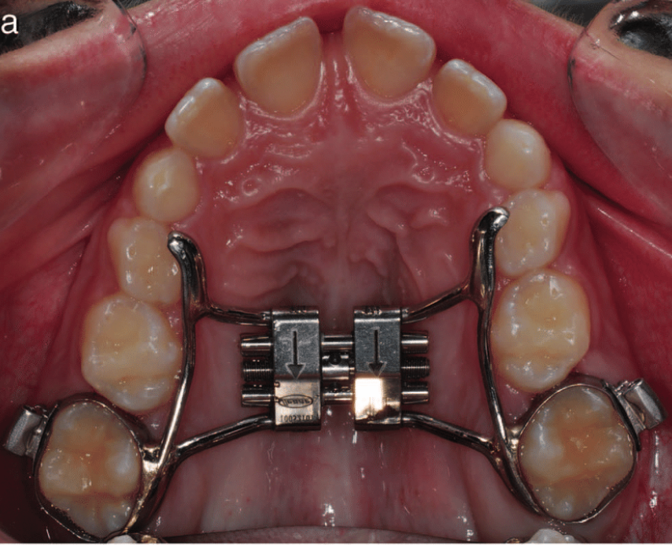
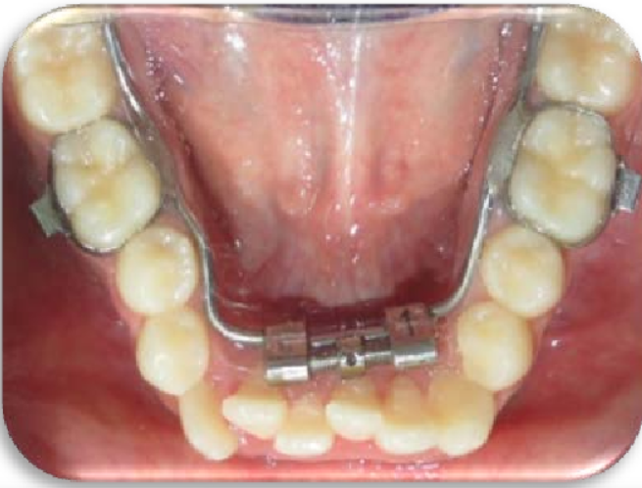
Treatment Modalities: Pediatric Orthopedics & Orthodontics

Slide 19
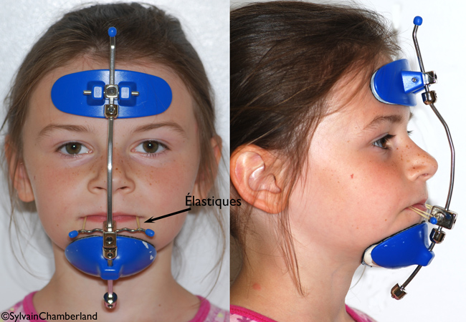
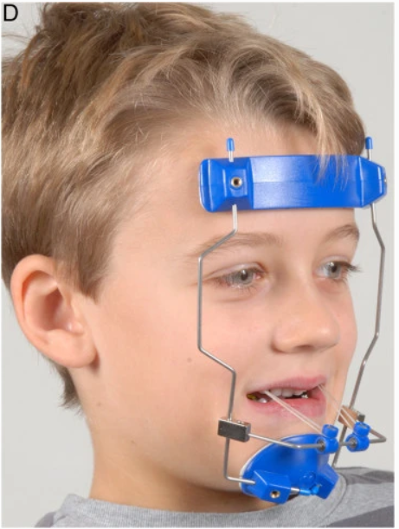
Treatment Modalities: Pediatric Orthopedics & Orthodontics
Nienkemper, M., Wilmes, B., Pauls, A. et al. Maxillary protraction using a hybrid hyrax-facemask combination. Prog Orthod. 14, 5 (2013). https://doi.org/10.1186/2196-1042-14-5

Slide 20
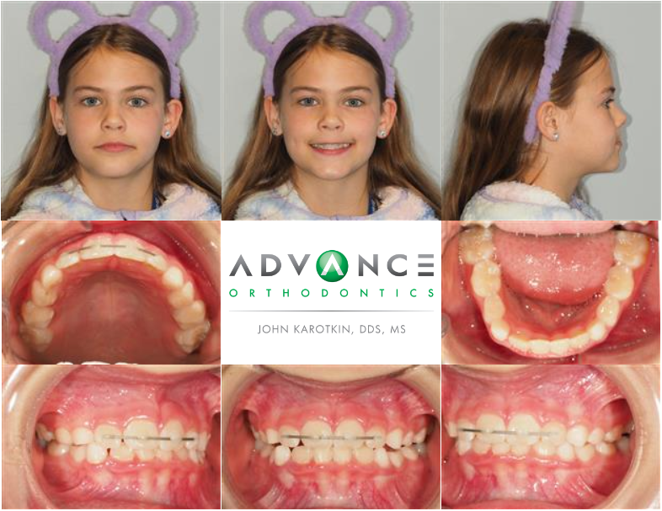
Treatment Modalities: Pediatric Orthopedics & Orthodontics

Slide 21
Case 2: Jeff

Slide 22
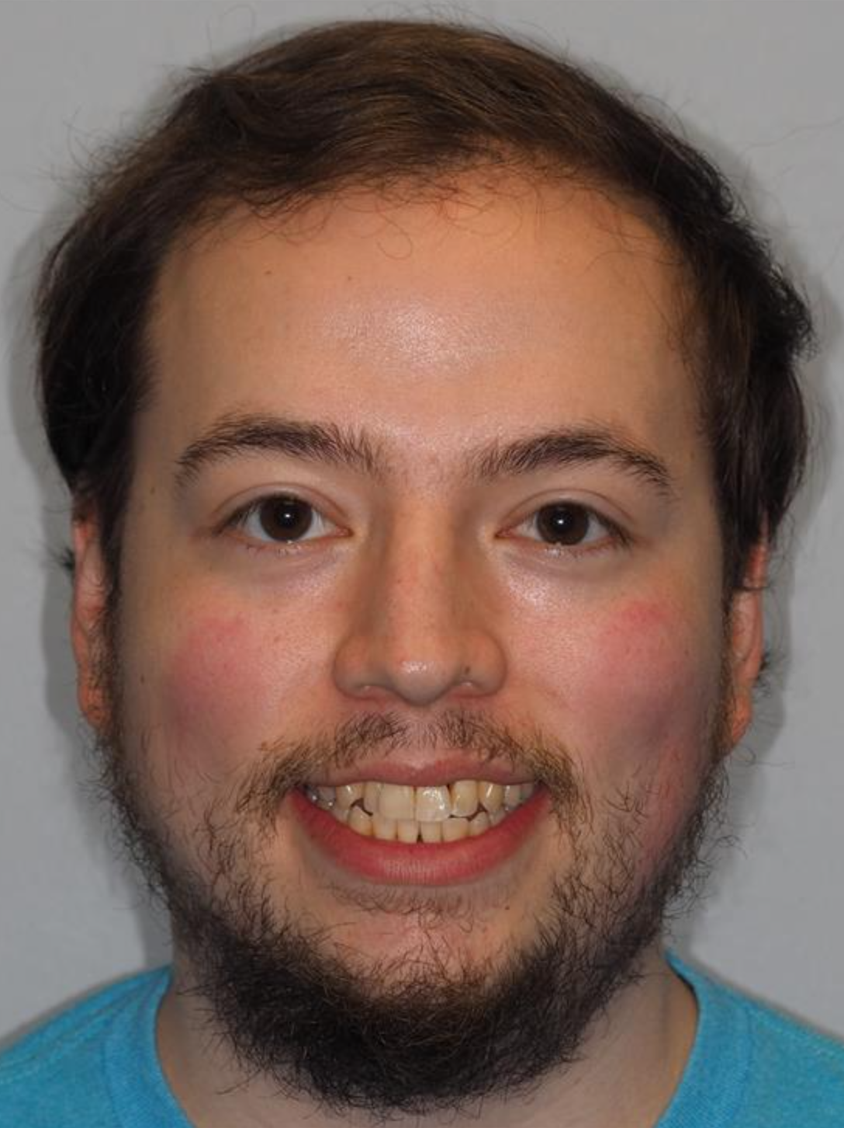
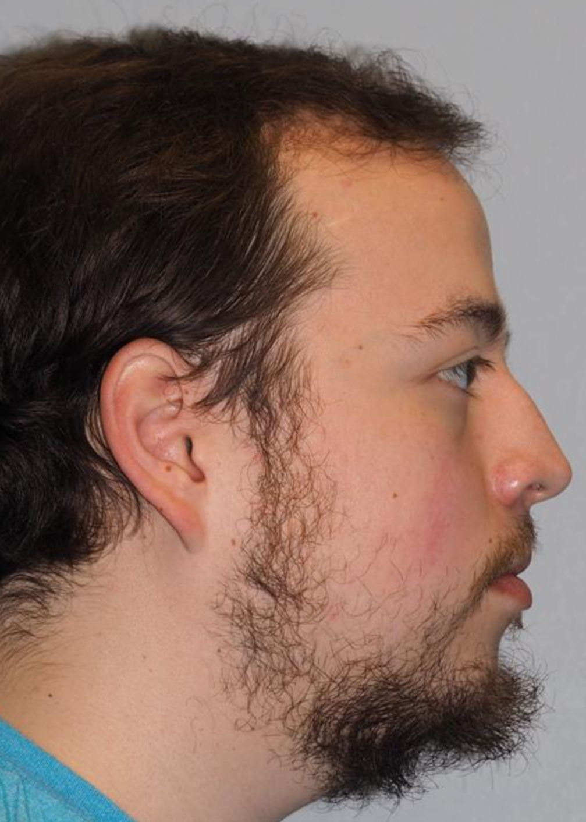
Treatment Modalities: MARPE + SFOT
Jeff
27 y/o M
Chief Concern: “Get a straight smile with healthy gums!”
Generalized aggressive periodontitis
Chronic sinusitis
Allergic rhinitis
Deviated nasal septum
Nasal turbinate hypertrophy
Mild OSA

Slide 23
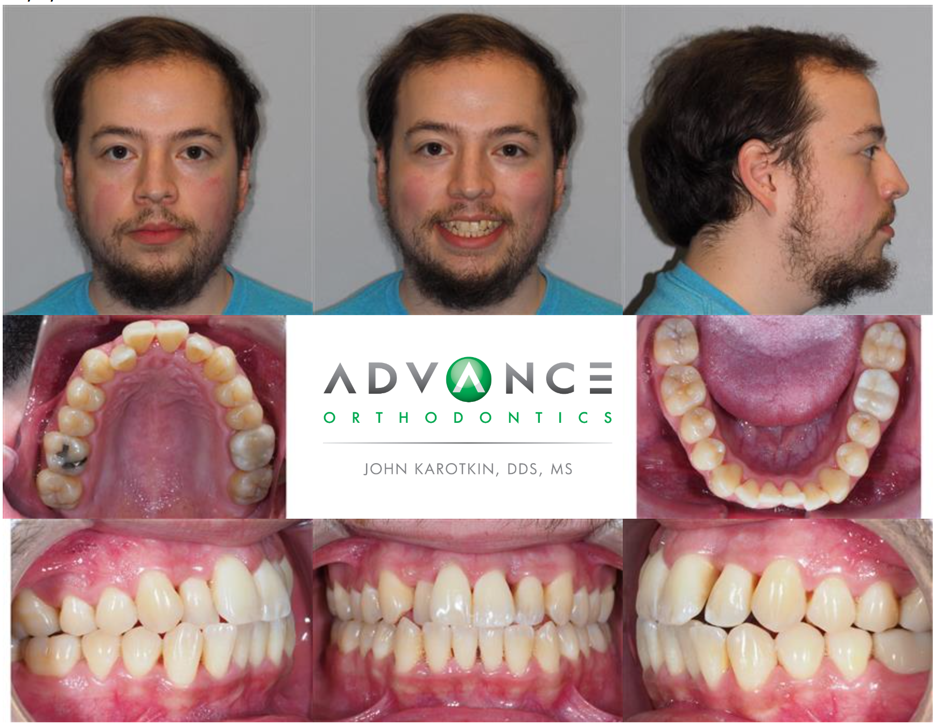
Treatment Modalities: MARPE + SFOT

Slide 24
Treatment Modalities: MARPE + SFOT
Plan
Endoscopic sinus surgery
Upper MARPE + Lower Invisalign® w/ SFOT
Remove MARPE + start OMT
Finish with U&L Invisalign®

Slide 25
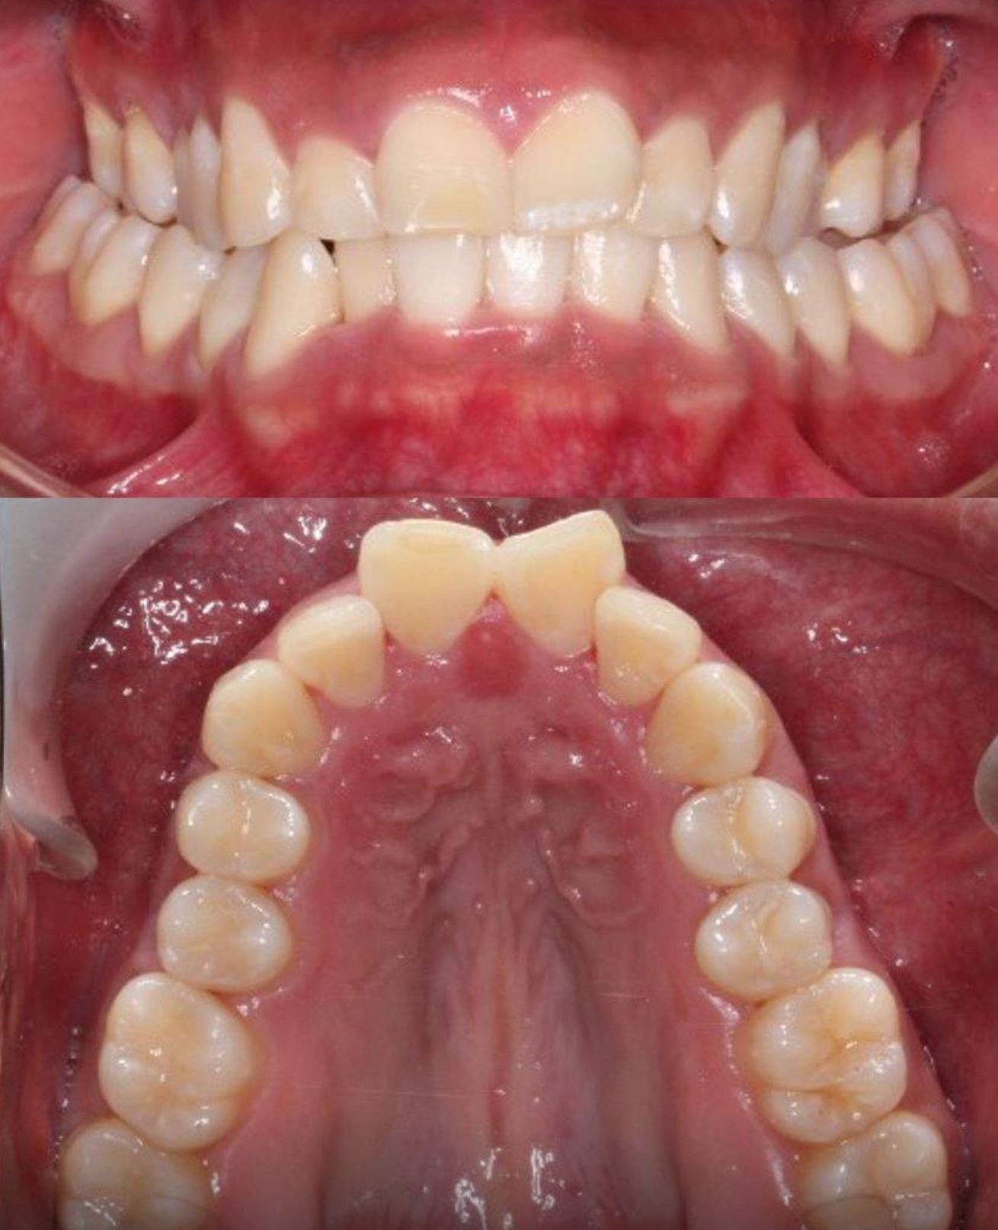
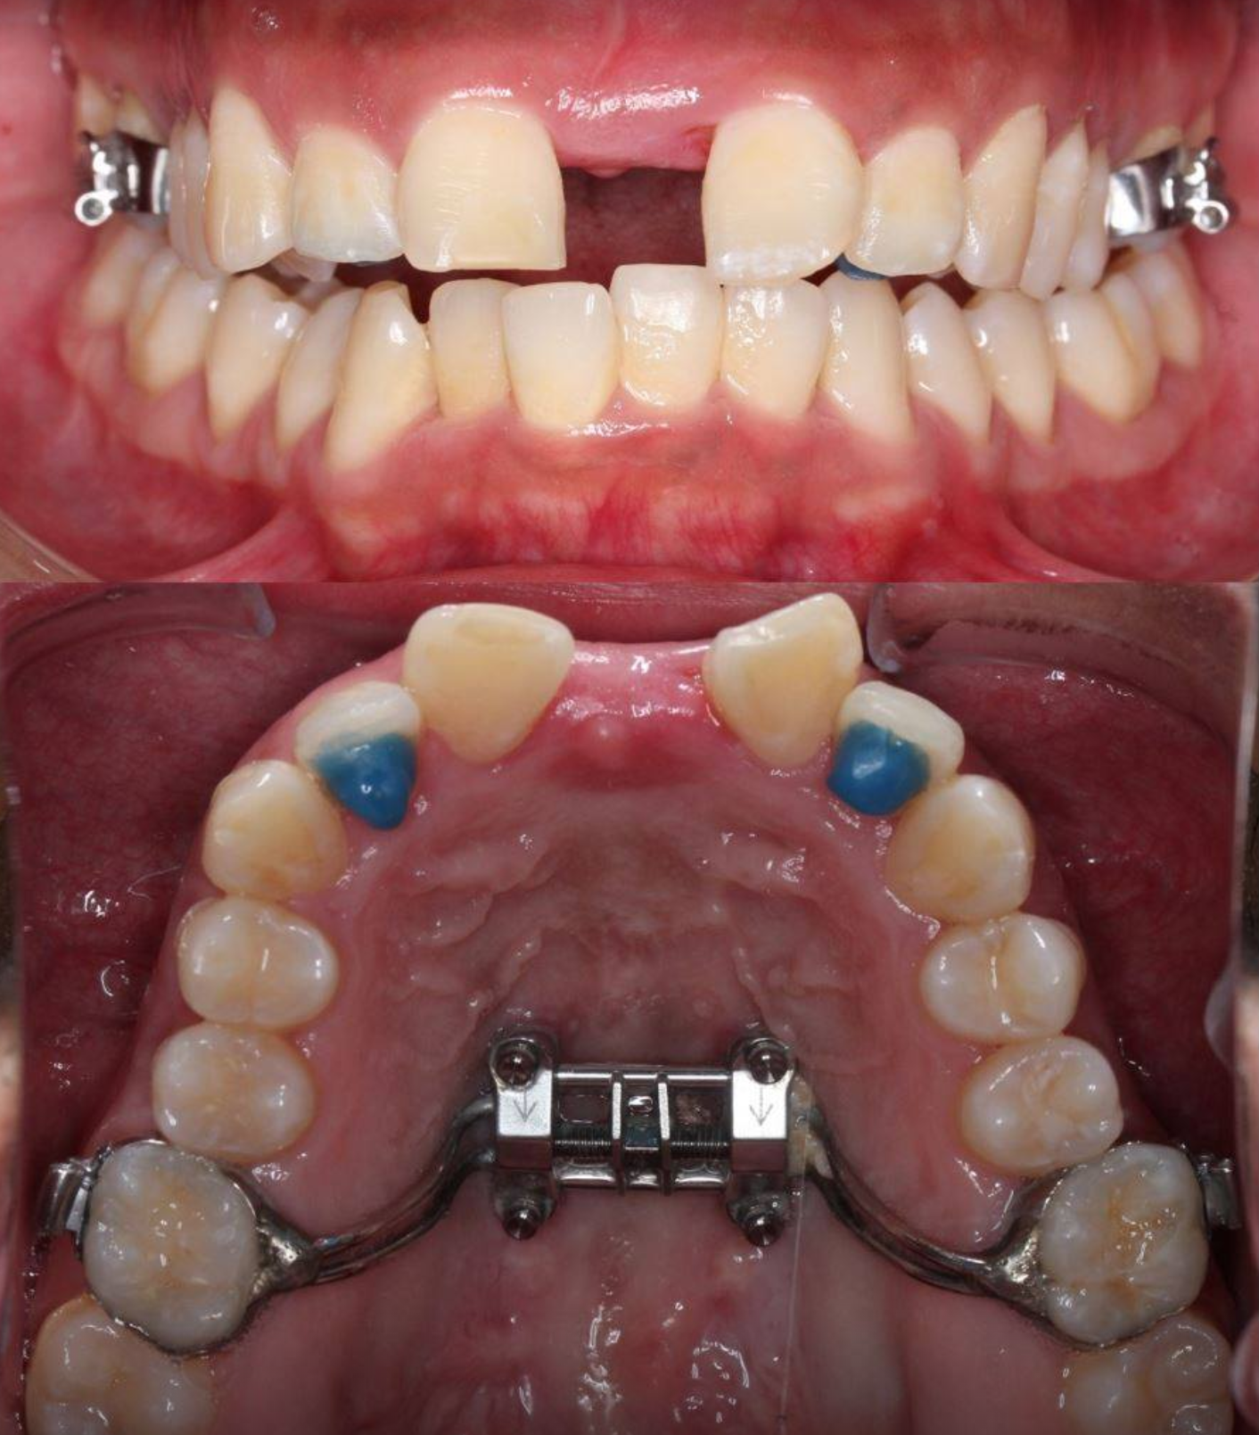
“Non-surgical” Maxillary Expansion
MARPE
Microimplant Assisted Rapid Palatal Expansion
Basal bone changes (LeFort III)
Maxillary only
Increases volume of…
Nasal cavity
Oral cavity (maxillary arch only)
Nasopharynx
Oropharynx
Photos: Dr. Won Moon
Notes:
Discuss marpe/braces with no sfot or with sfot and with Ong

Slide 26
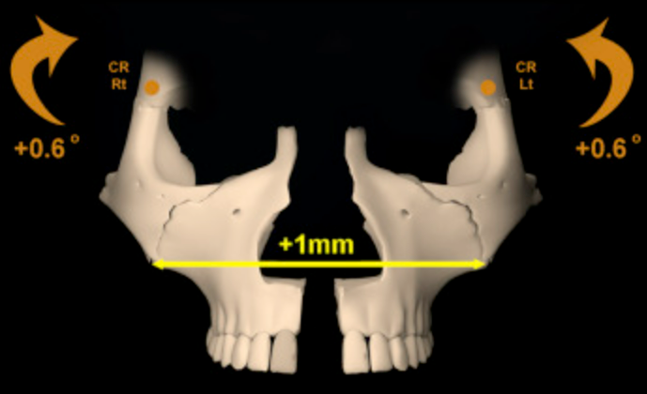
Dr. Marianna Evans

Slide 27
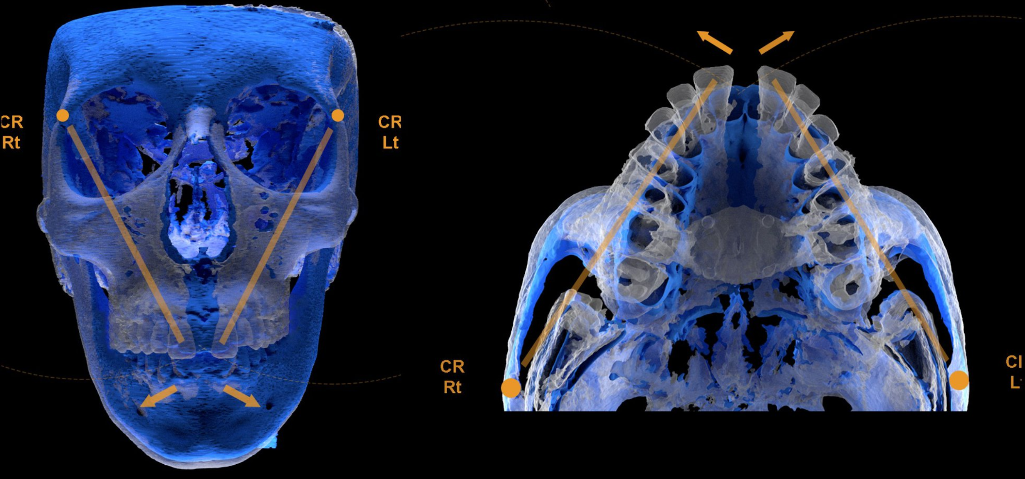
Cantarella, D., et al. Midfacial changes in the coronal plane induced by microimplant-supported skeletal expander, studied with cone-beam computed tomography images. AJO-DO. 154, 3 (2018). https://doi.org/10.1016/j.ajodo.2017.11.033
A significant lateral displacement of the zygomaticomaxillary complex occurred in late adolescent patients treated with a bone-anchored maxillary expander. The zygomatic bone tended to rotate outward along with the maxilla with a common center of rotation located near the superior aspect of the frontozygomatic suture. Dental tipping of the molars was negligible during treatment.

Slide 28
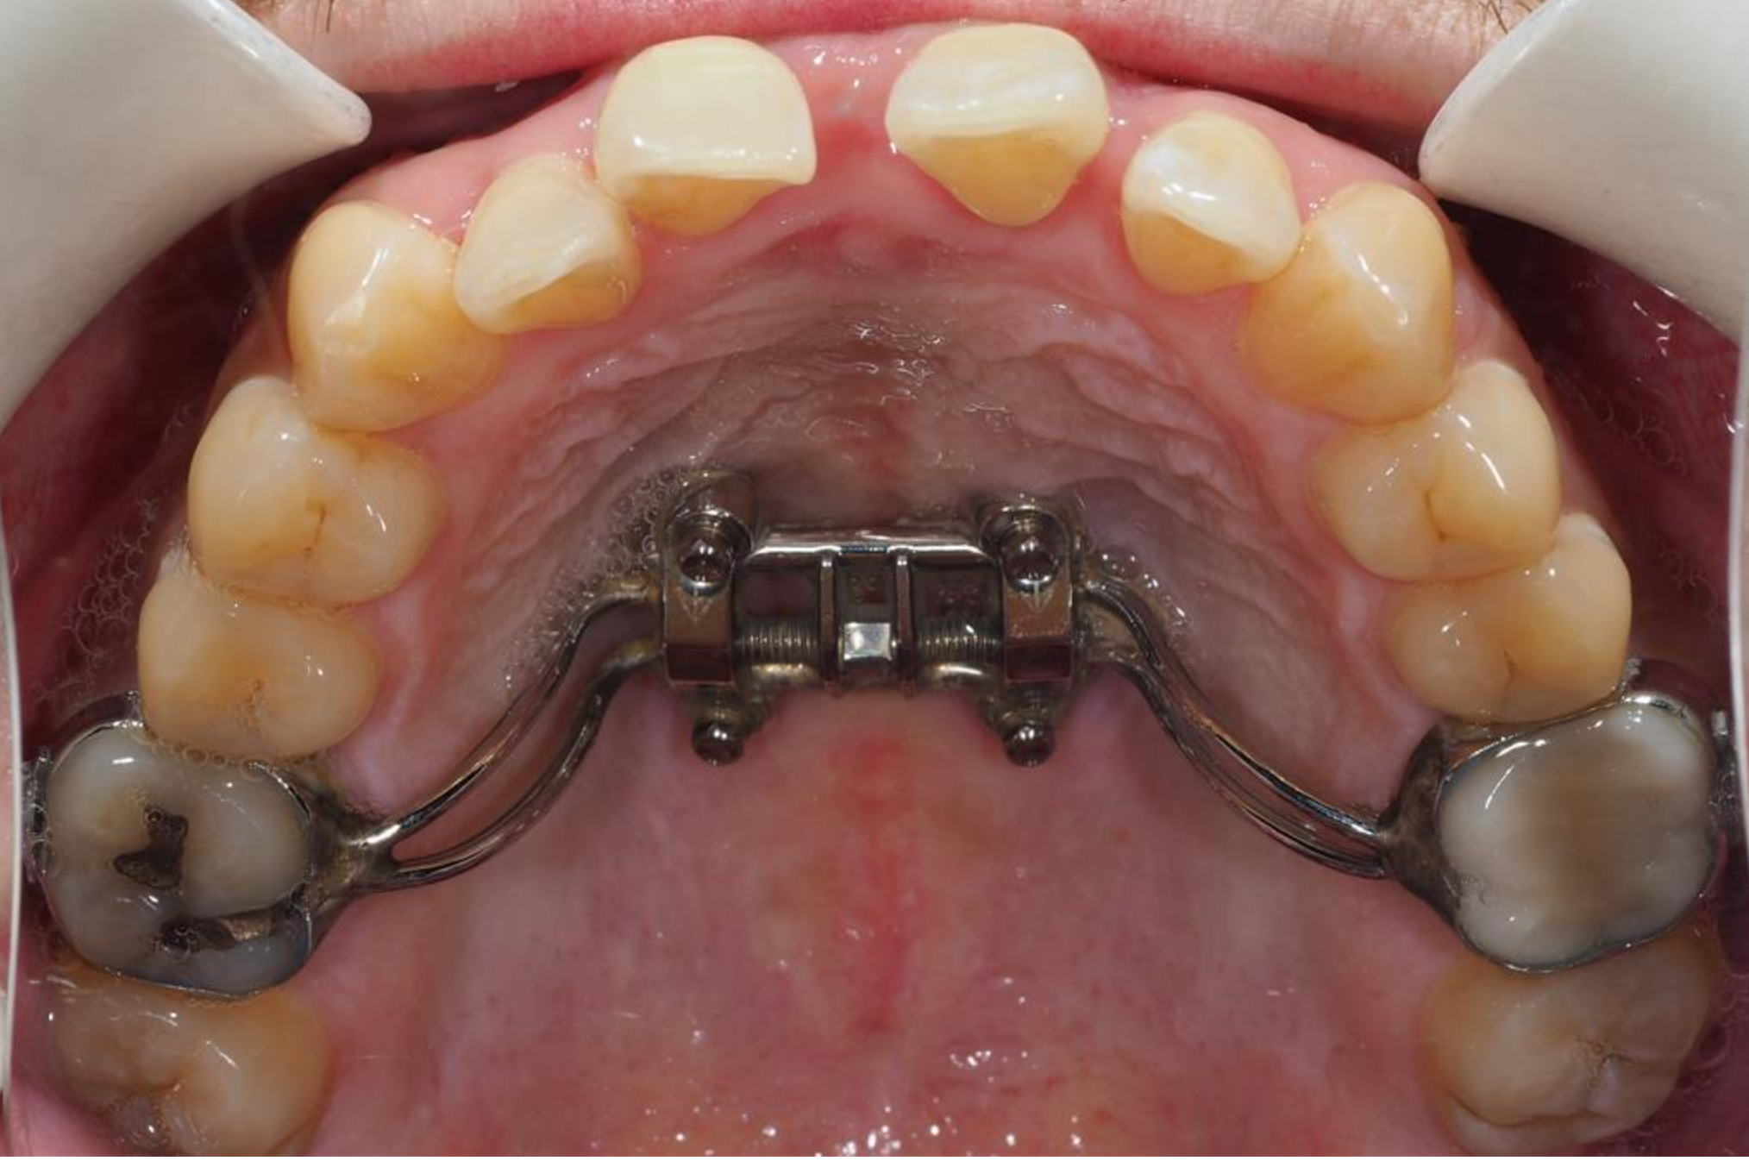
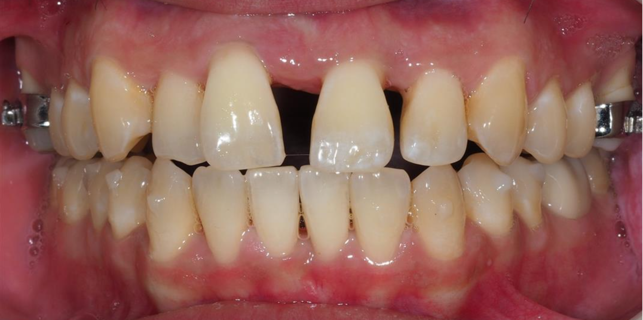
Treatment Modalities: MARPE + SFOT

Slide 29
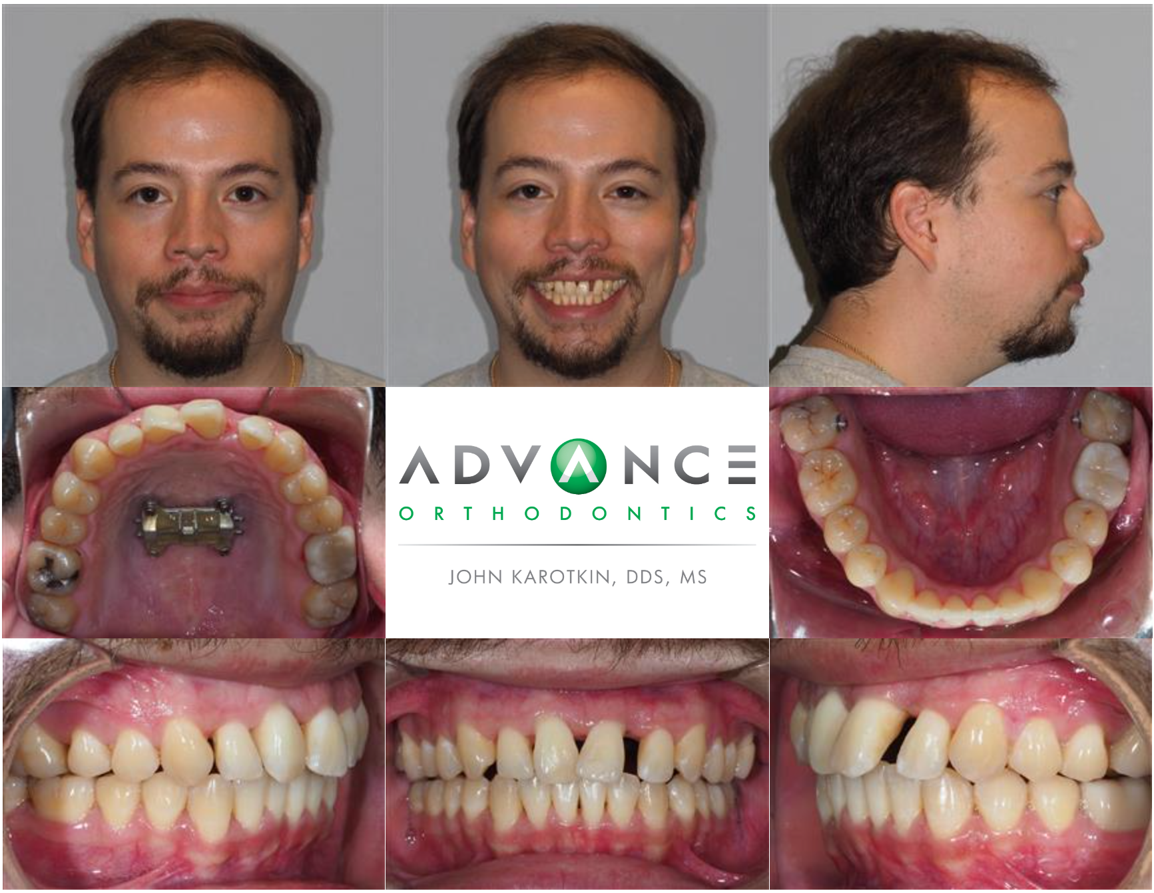
Treatment Modalities: MARPE + SFOT

Slide 30
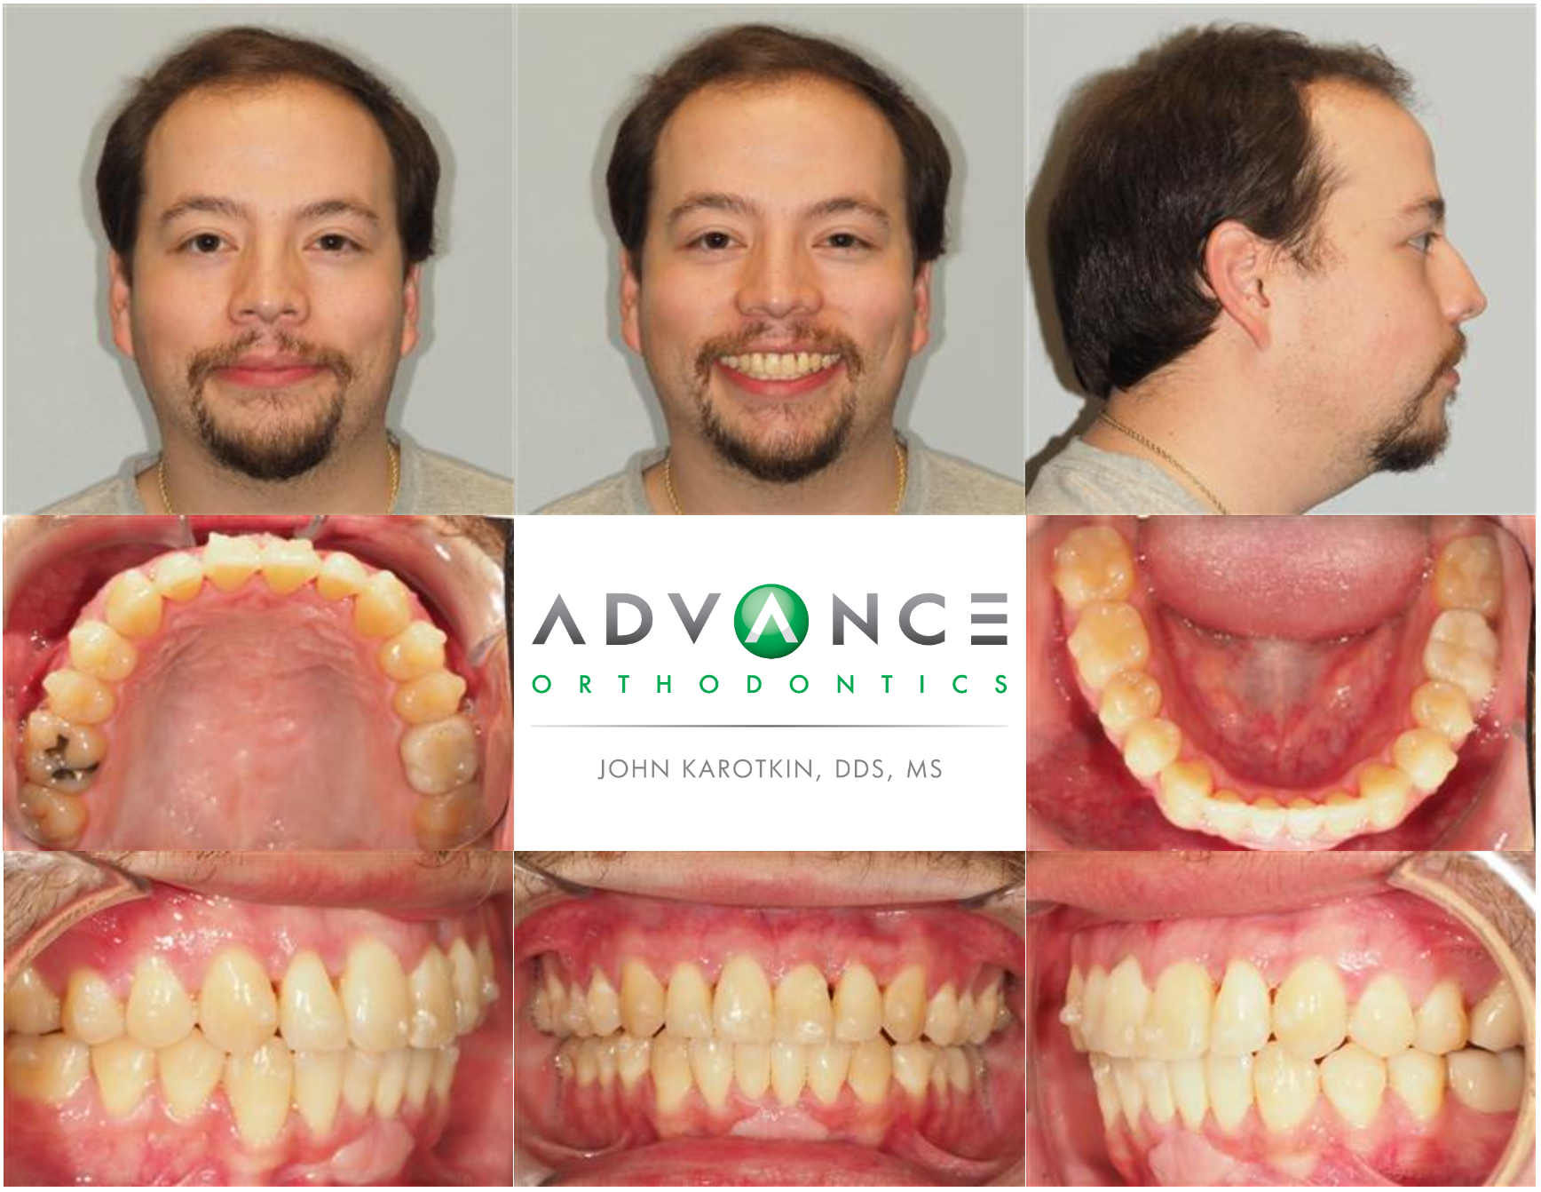
Treatment Modalities: MARPE + SFOT

Slide 31
Treatment Modalities: MARPE + SFOT

Slide 32
Case 3: Zach

Slide 33
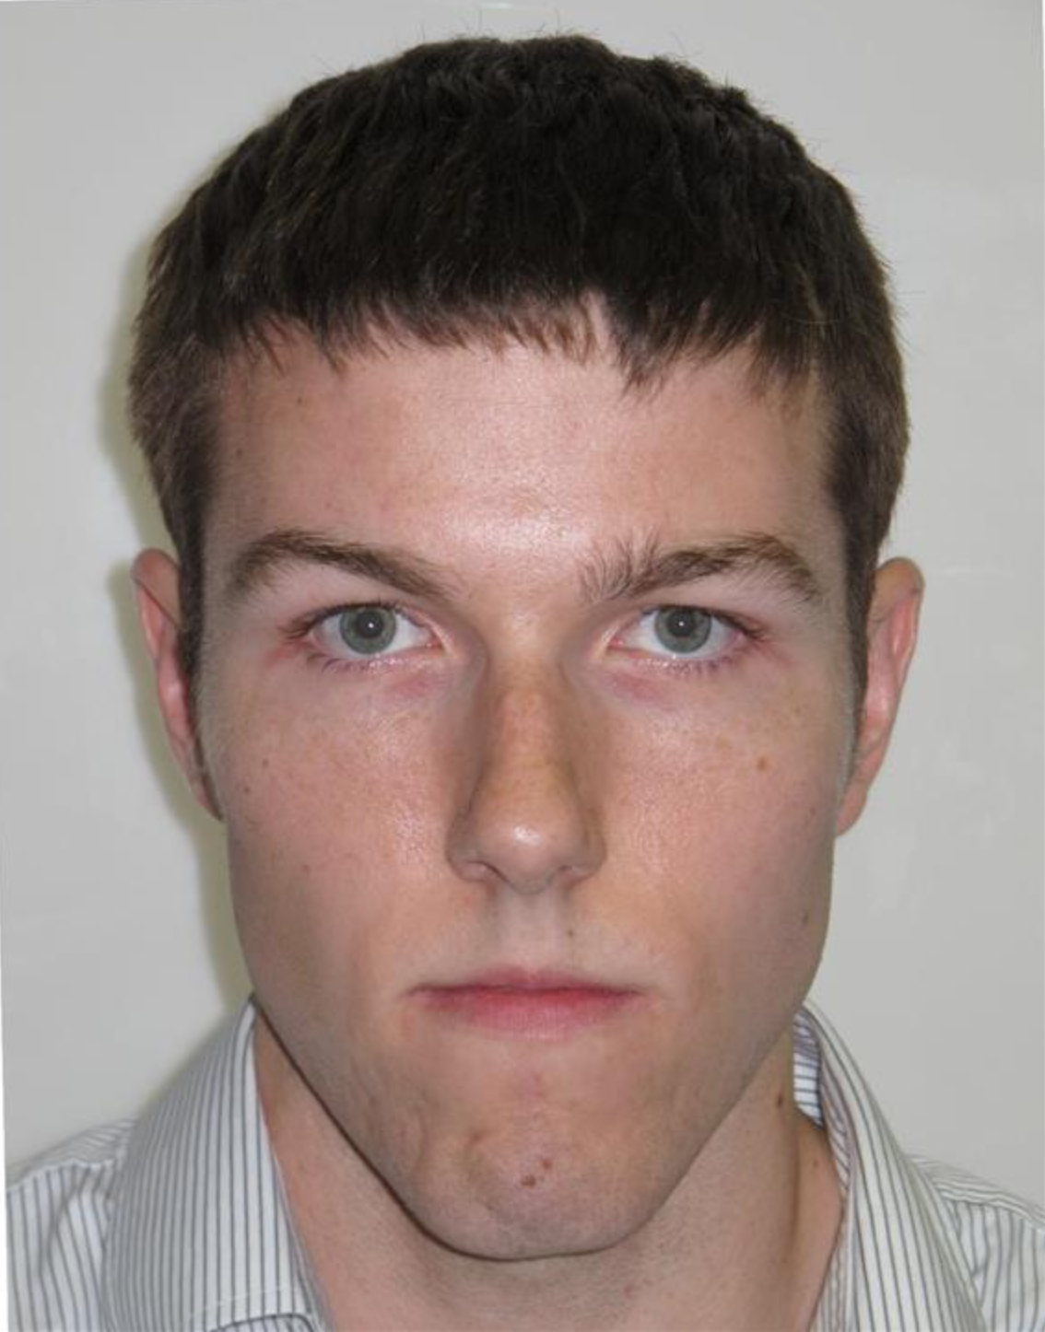
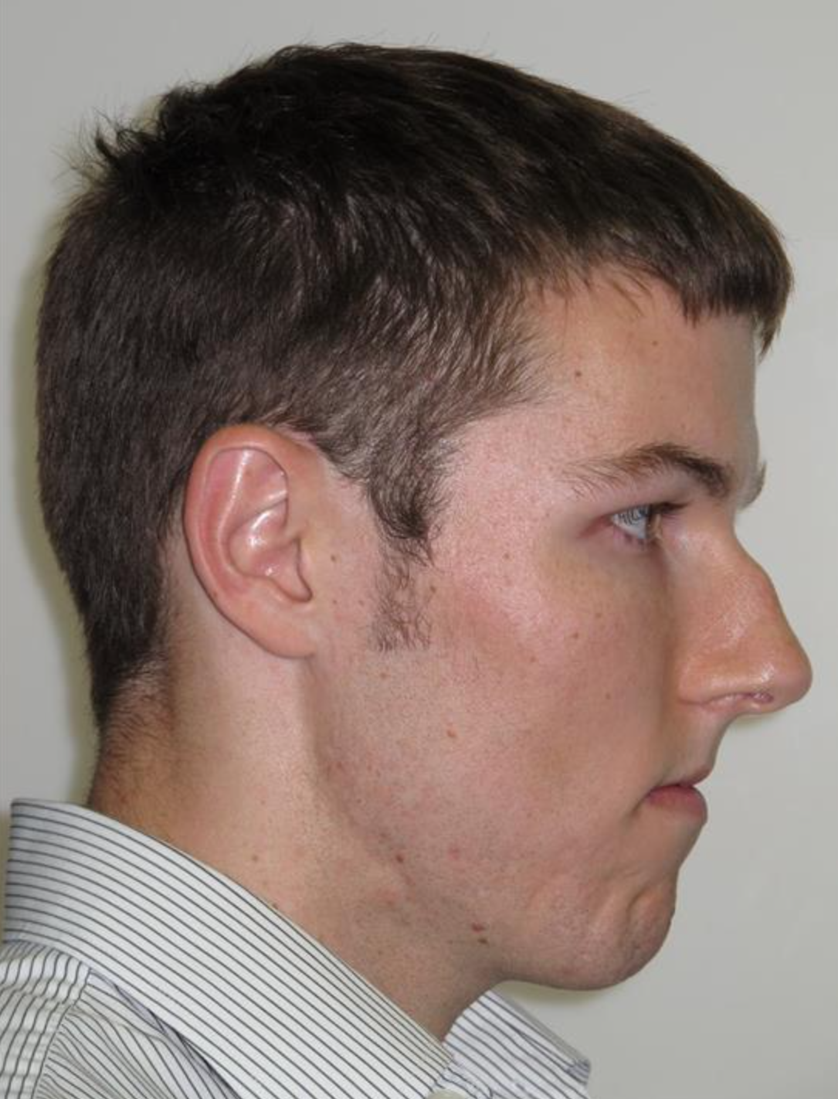
Treatment Modalities: Surgical Orthodontics
Zach
21 y/o M
Chief Concerns:
Open bite
Crowding of lower teeth
Skeletal Class III
Highly arched, narrow palate
Mouth breathing
Lip strain

Slide 34
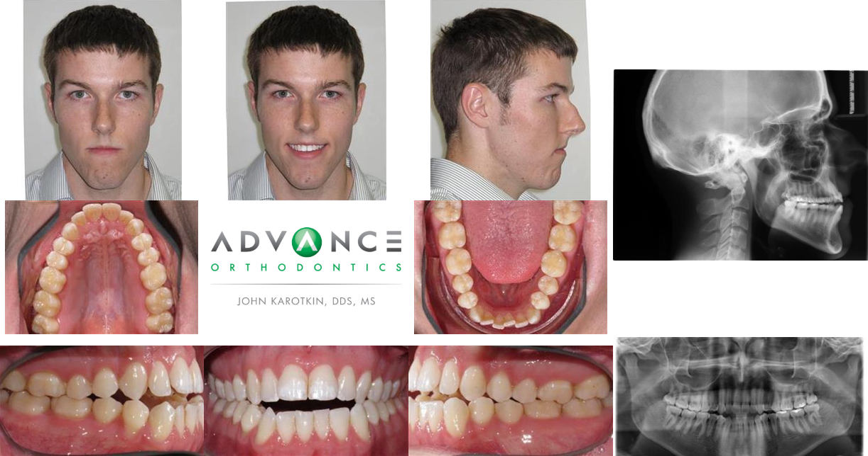
Treatment Modalities: Surgical Orthodontics

Slide 35
Treatment Modalities: Surgical Orthodontics
Plan
U&L Braces
Align & decomp
OMT (pre-surgical)
MMA surgery
OMT (post-surgical)
Orthodontic finishing

Slide 36
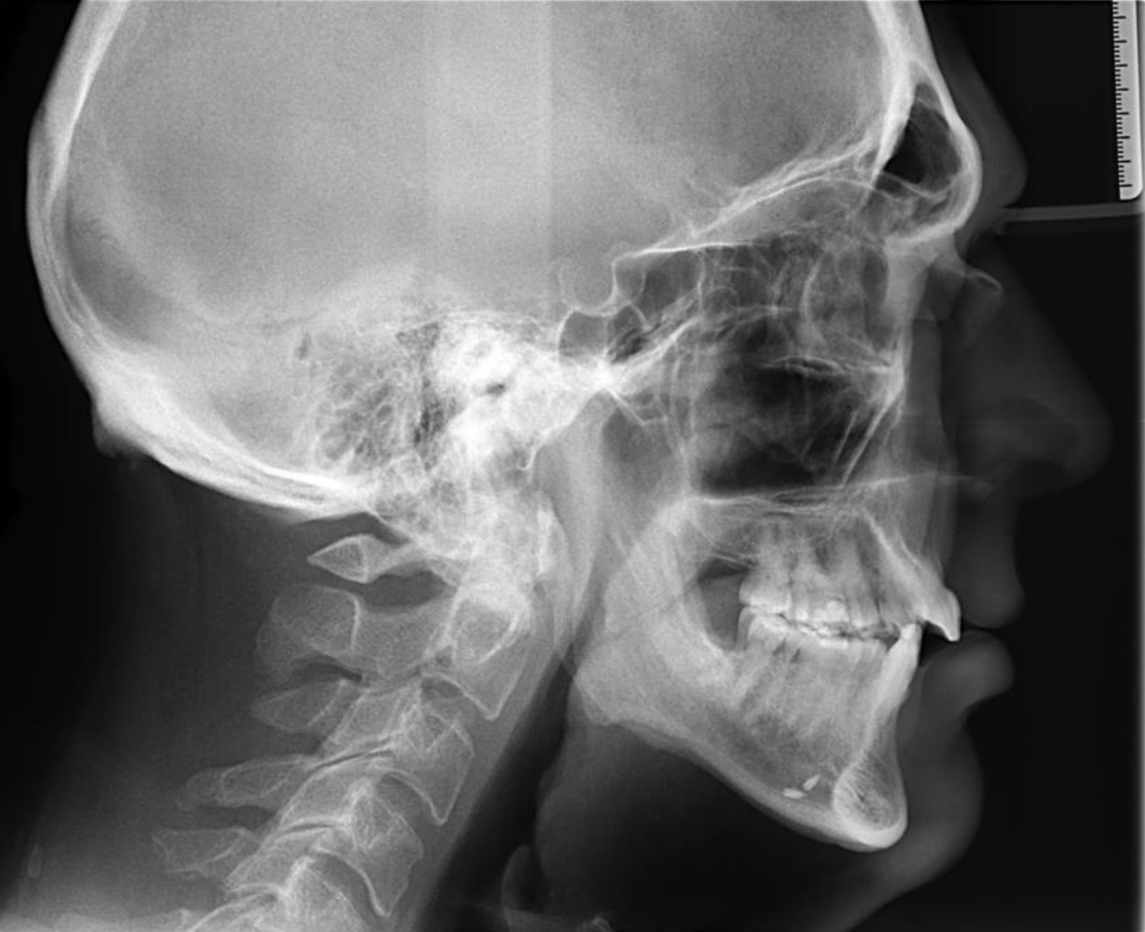
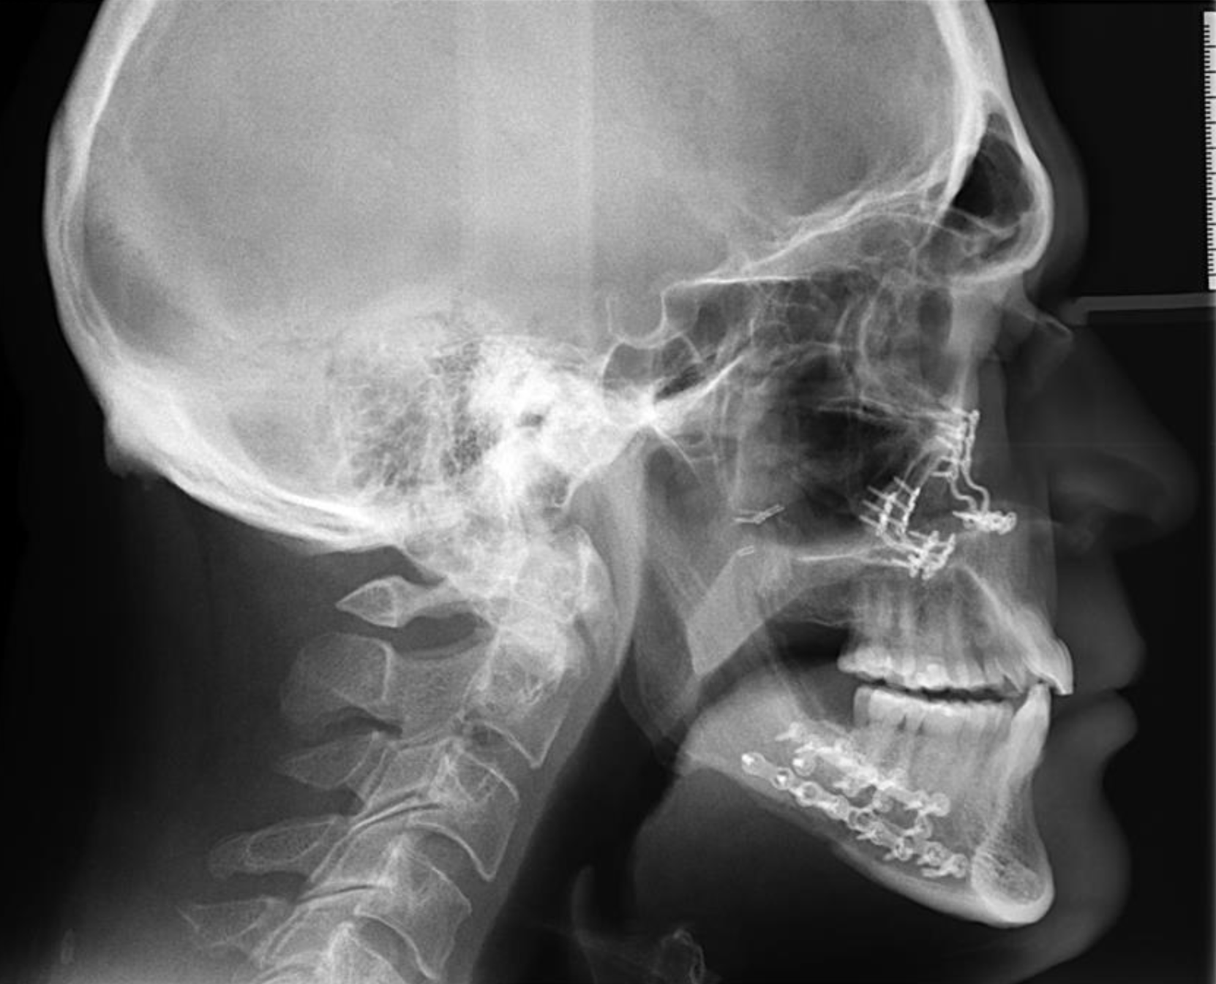
MMA (Maxillomandibular Advancement) Surgery
Increases pharyngeal airway volume by moving the maxillary and mandibular jaw anteriorly.

Slide 37
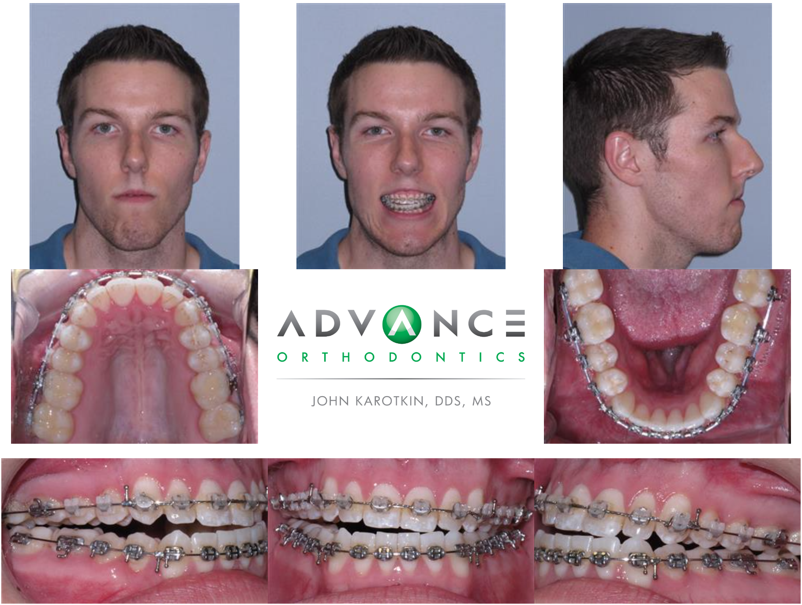
Treatment Modalities: Surgical Orthodontics

Slide 38
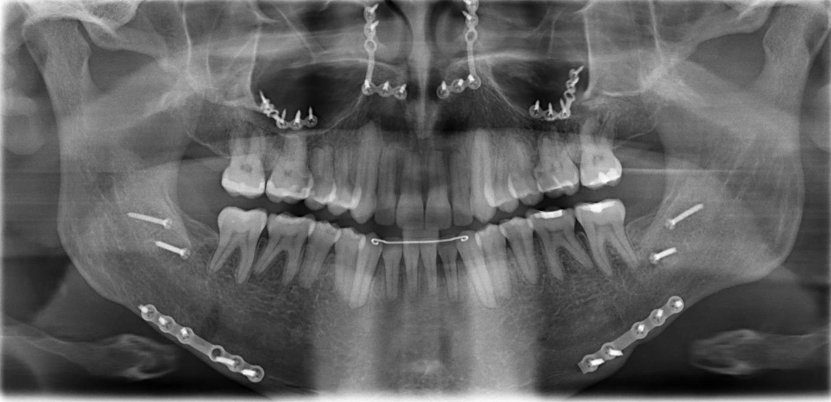
Treatment Modalities: Surgical Orthodontics

Slide 39
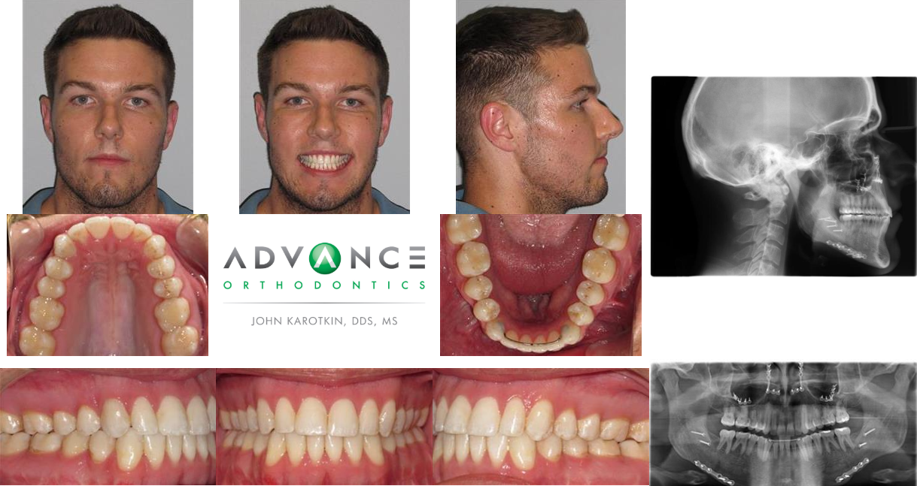
Treatment Modalities: Surgical Orthodontics

Slide 40
Team@AdOrthodontics.com
Doc@AdOrthodontics.com
Thank you!

