Slide 1


Slide 2

Susi Quintana, RDH, BS, COM
Certified Orofacial Myologist
Myofunctional Method, LLC
HoustonMyofunctionalTherapy.com
I graduated from
The University of Texas, Houston Dental Branch in 2000.
I did my OMT training and became board certified
with the IAOM
(International Association of Orofacial Myology).

Slide 3
Objectives:
Understanding of how form and function support each other
  If you only correct the structures and not the function that lead to the concerning structures you will jeopardize your results.
  What is myofunctional therapy?
Why it takes a team approach
  We all have our specialties but they all overlap to some degree
  Our patients benefit from us communicating and collaborating
Who is on this team?
What’s the order of how to address things?

Slide 4
What is OMT?
(orofacial myofunctional therapy)
“an individualized program to help the patient retrain… muscle function, and to create and maintain a healthy orofacial environment”
“Myofunctional therapy is an integral part of orthodontics and may shorten orthodontic treatment time, as well as prevent orthodontic relapse. Those patients experiencing TMJ pain and dysfunction, obstructive sleep apnea (OSA), or upper airway resistance syndrome (UARS) may also benefit from orofacial myofunctional therapy as part of an interdisciplinary plan of care…
The treatment of patients may be provided by an interdisciplinary healthcare team that includes COM®s, dentists, oral surgeons, sleep medicine specialists, ENTs, and bodywork professionals”
IAOM.COM website

Slide 5
Who does it benefit?
Kids, Teens, Adults (not infants or toddlers)
· Chronic pain patients - TMJD patients – clenchers and grinders
· Orthodontic patients – open bite, narrow dental arches, crowding
· Jaw surgery patients
· Sleep disordered breathing patients
· Mouth breathers
· Those with poor oral health
· Those with oral habits – thumb or finger sucking
· Those with digestive issues
IAOM.COM website

Slide 6
GOALS of OMT:
Oral Rest Posture

Slide 7
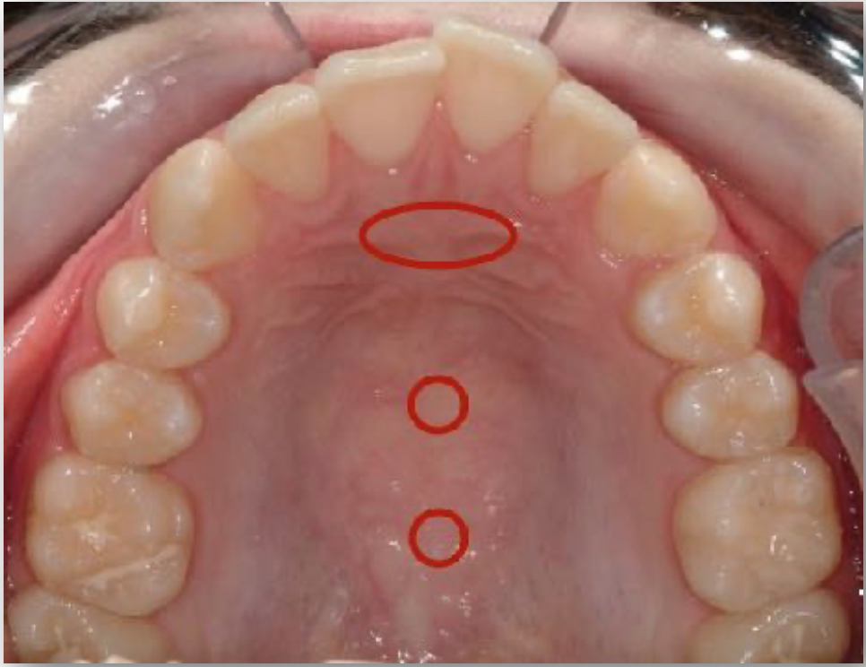
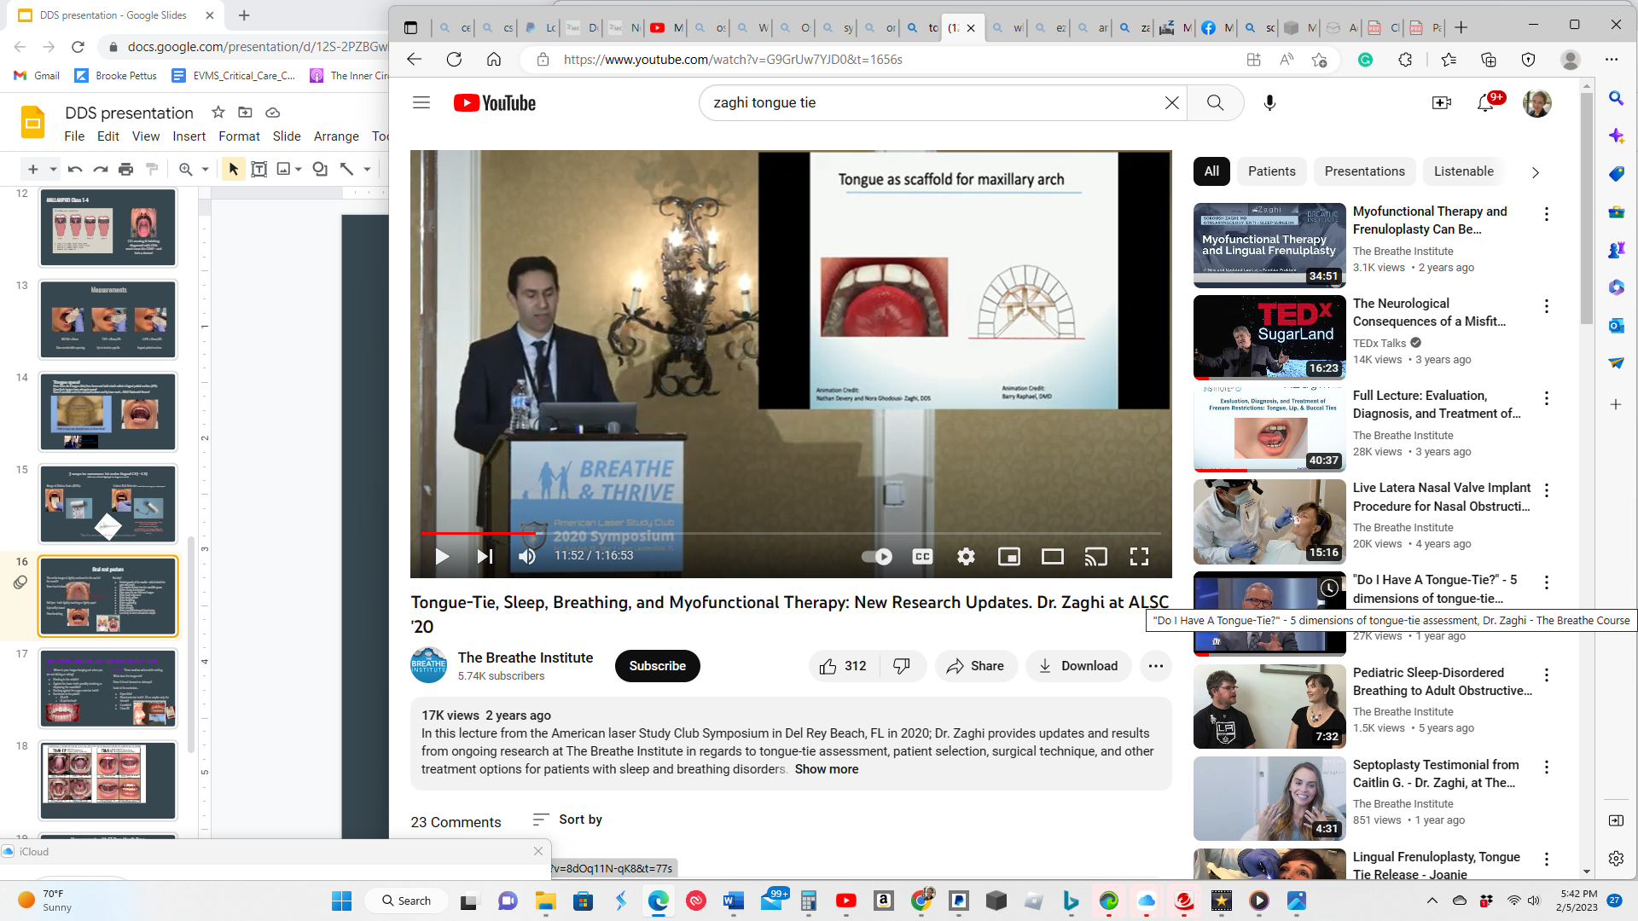
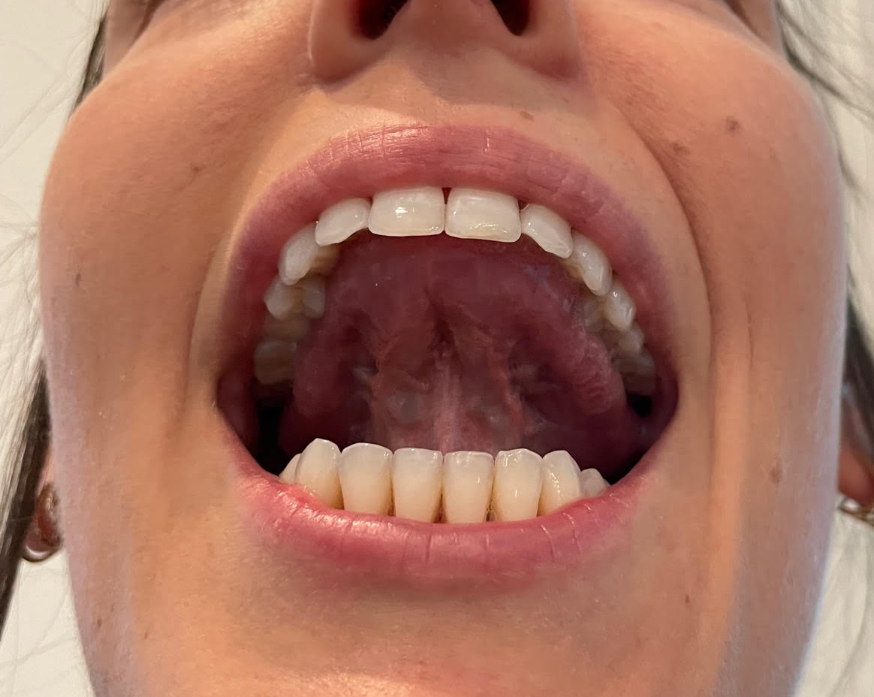
Oral rest posture
The entire tongue is lightly suctioned to the roof of the mouth!
From front to back:
Soft jaw - teeth lightly touching or lightly apart
Lips softly closed
Nose breathing
The tongue spot

Slide 8
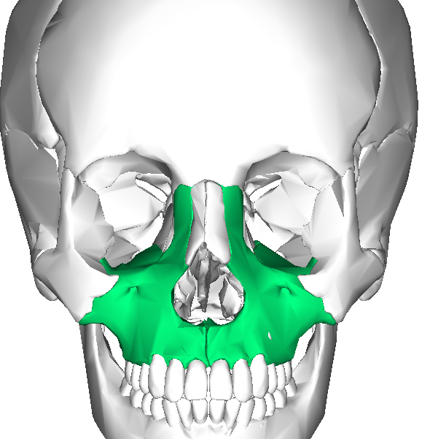
The Maxilla = the nasal cavity and the upper jaw
The tongue is meant to rest in the palate/maxilla starting in utero begins shaping the palate. This continues with breastfeeding and proper oral rest posture

Slide 9
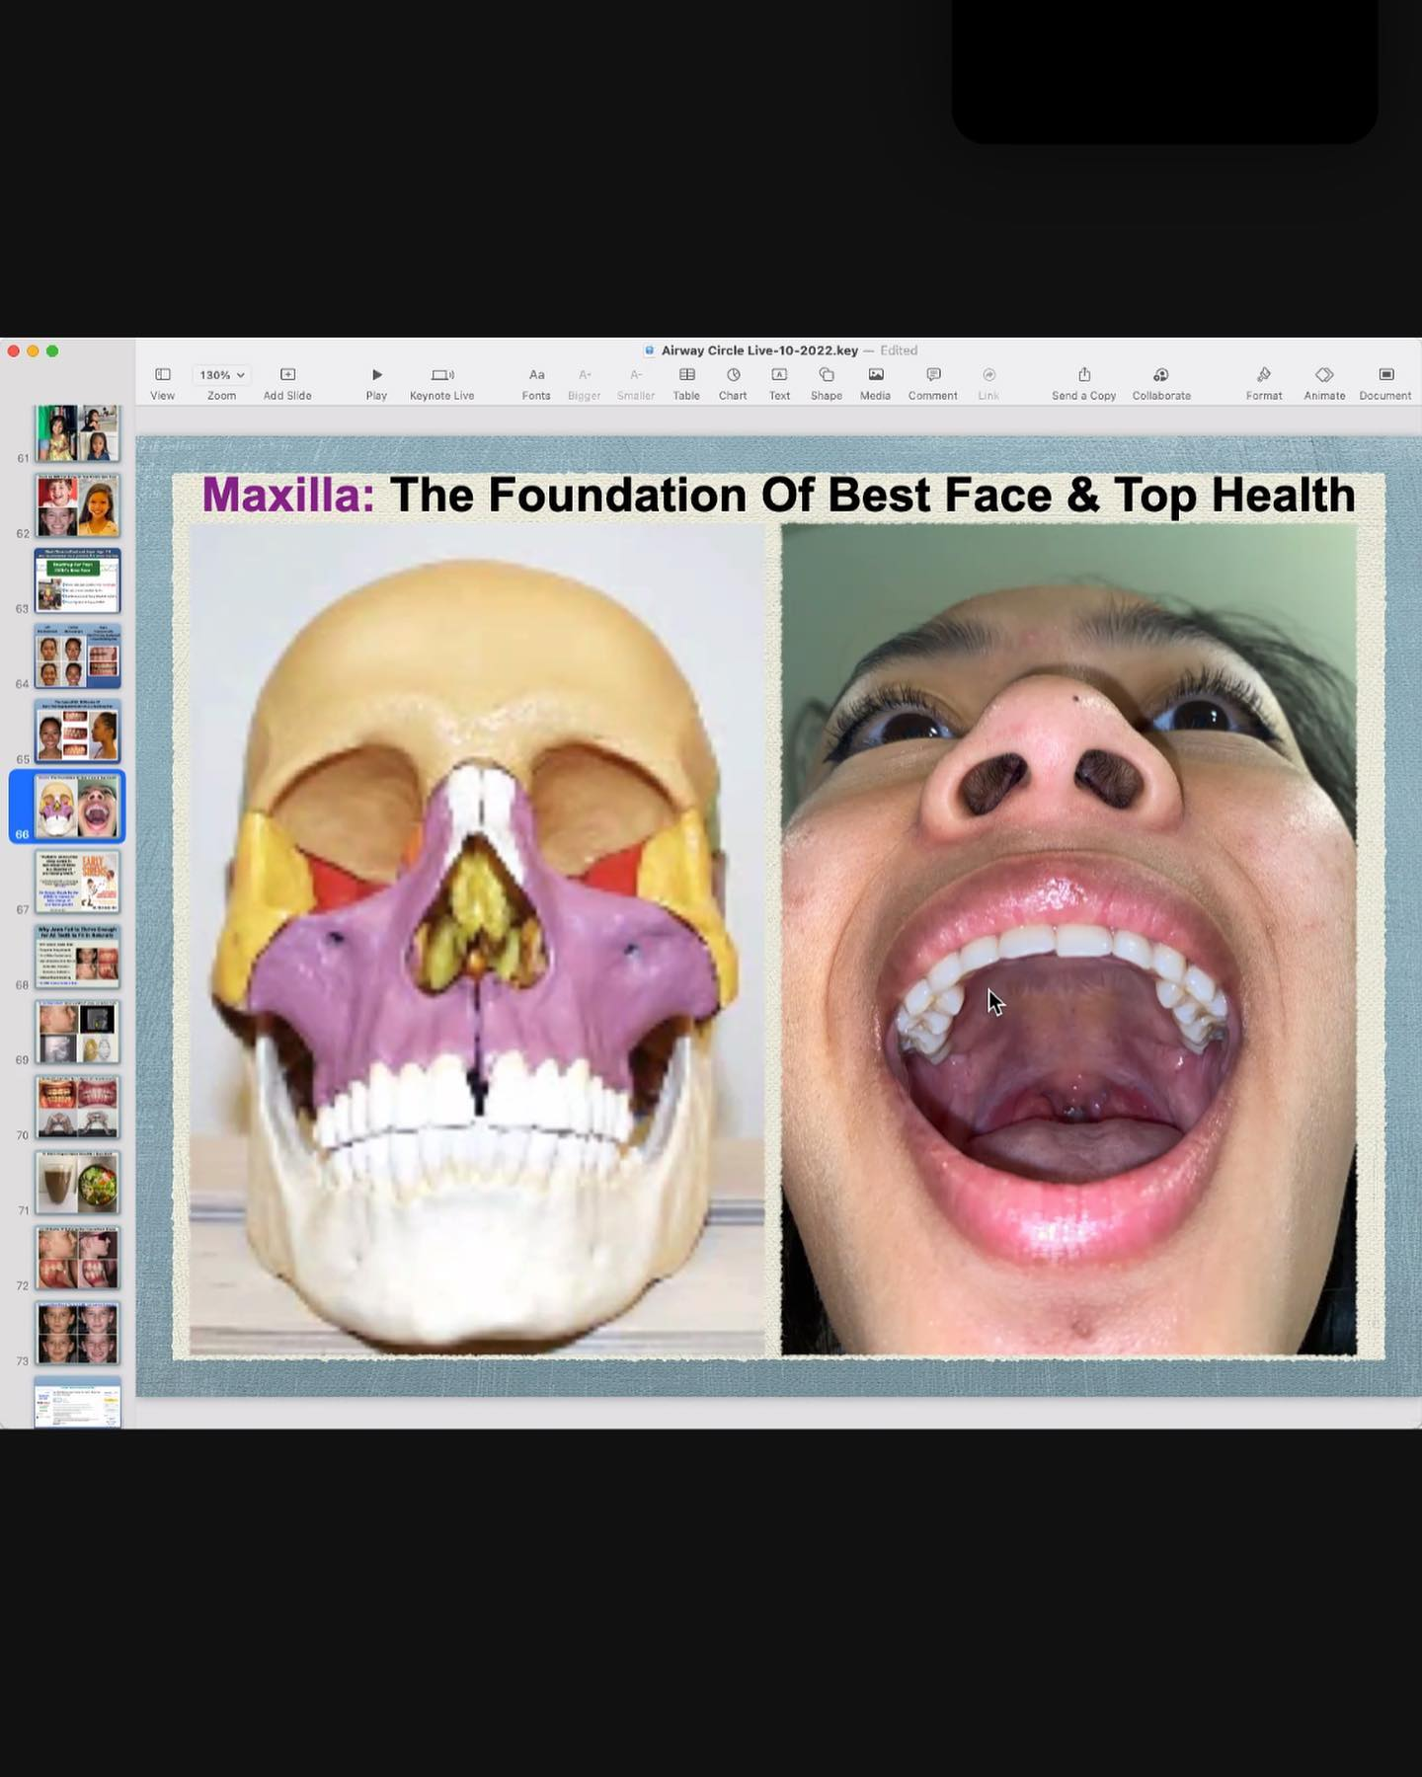
Why is tongue posture important?
IT CREATES BETTER…
Posture
Breathing
Swallowing
Talking
Sleeping
Growth of the maxilla - which is both the nose and mouth
Airway development
Heart/brain/overall functioning
Helps keep our bodies in parasympathetic mode
Orthodontic success
The top of the mouth is also the nose
By: Felix Liao

Slide 10
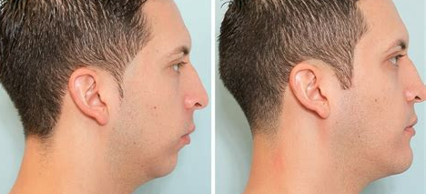
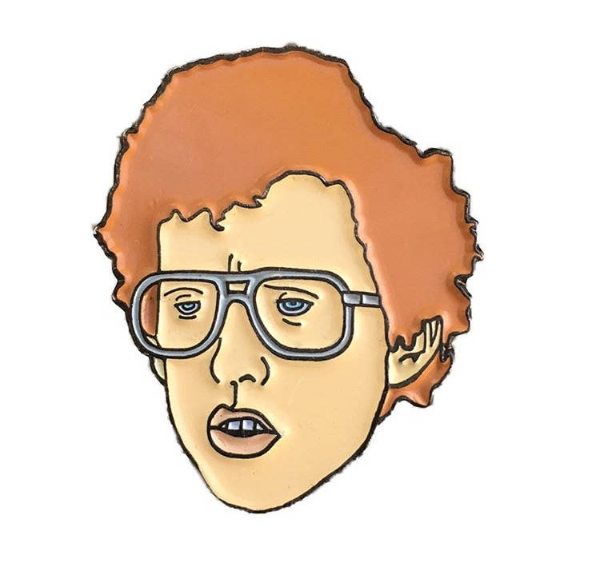
Look at the facial profile… Mouth breathing leads to a long underdeveloped face...

Slide 11
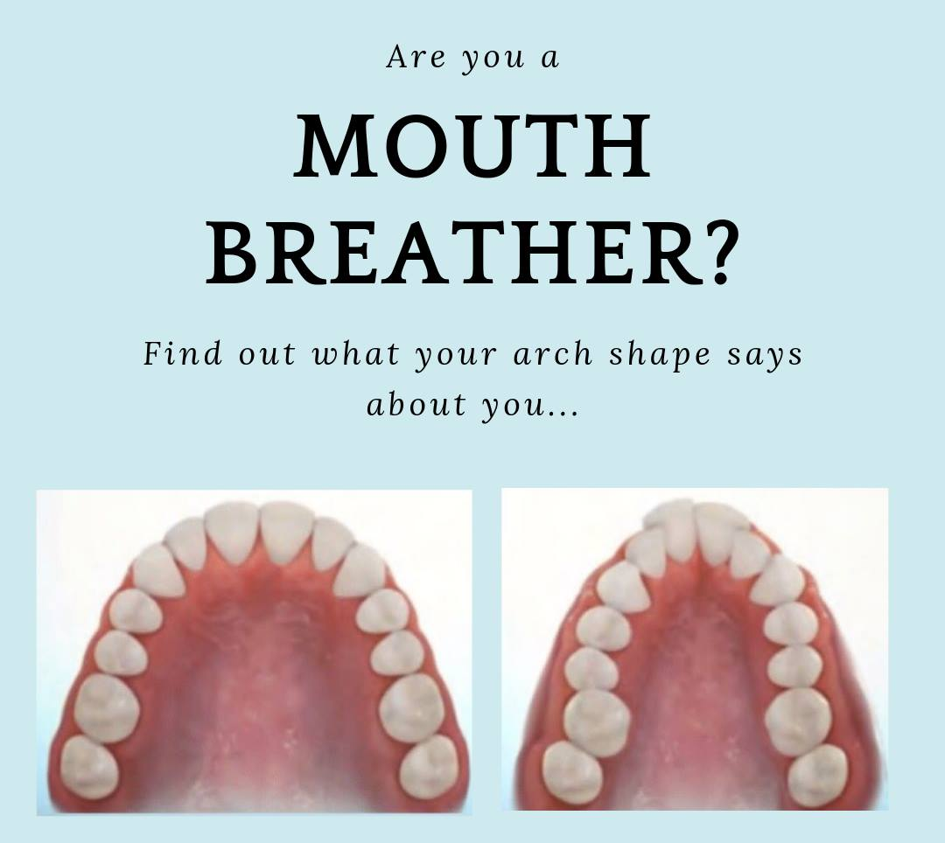
Always look at the maxilla (palate) to
tell a story!!!
Vaulted?
Narrow?
Crowded teeth?
Pronounced rugae?
“Thumb print palate”?
Is it like the Astrodome?
Is it like a church ceiling?
Astrodome
Church ceiling

Slide 12
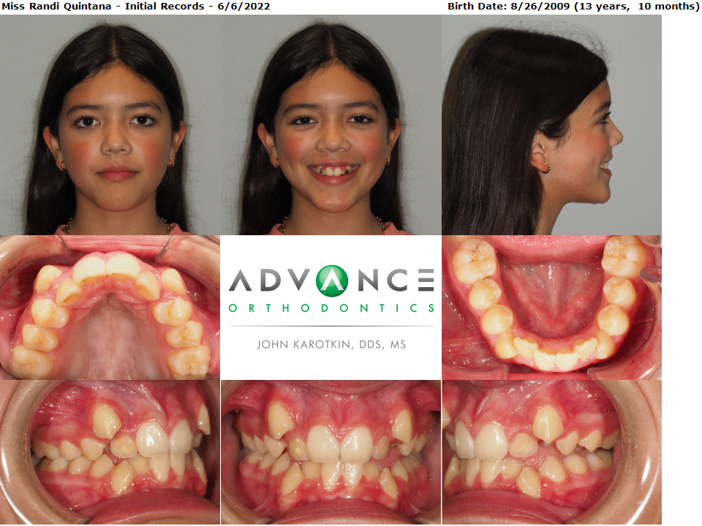
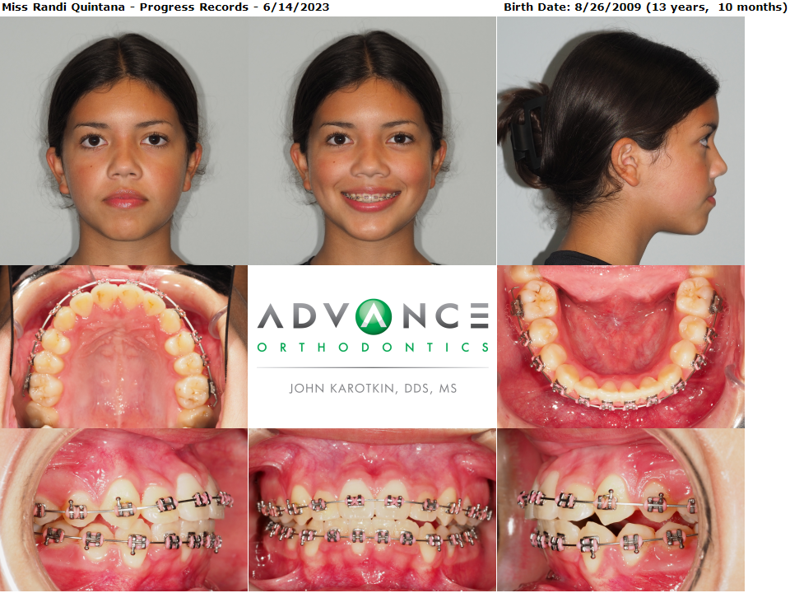
Constricted Upper Airway & Sleep Disordered Breathing
VAULTED CEILING (Maxilla)
Mouth Breather
Sympathetic Nervous System
DOME CEILING (Maxilla)
Nose Breather
Parasympathetic Nervous System

Slide 13
What does an OMD lead to?
Poor body posture and chronic pain
Poor oral health
Worn teeth from clenching and grinding
Malocclusion needing orthodontics
Orthodontic relapse if not corrected
Changes associated with abnormal jaw growth and jaw position
Jaw surgery relapse if not corrected
IAOM.COM website

Slide 14
Form and Function depend on each other
You can’t expect to have complete predictability and success if you only address one!

Slide 15
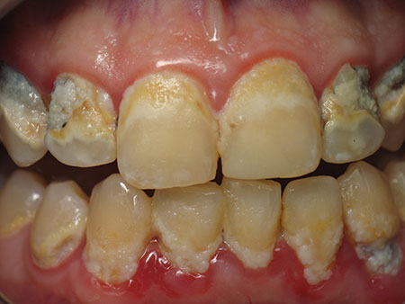
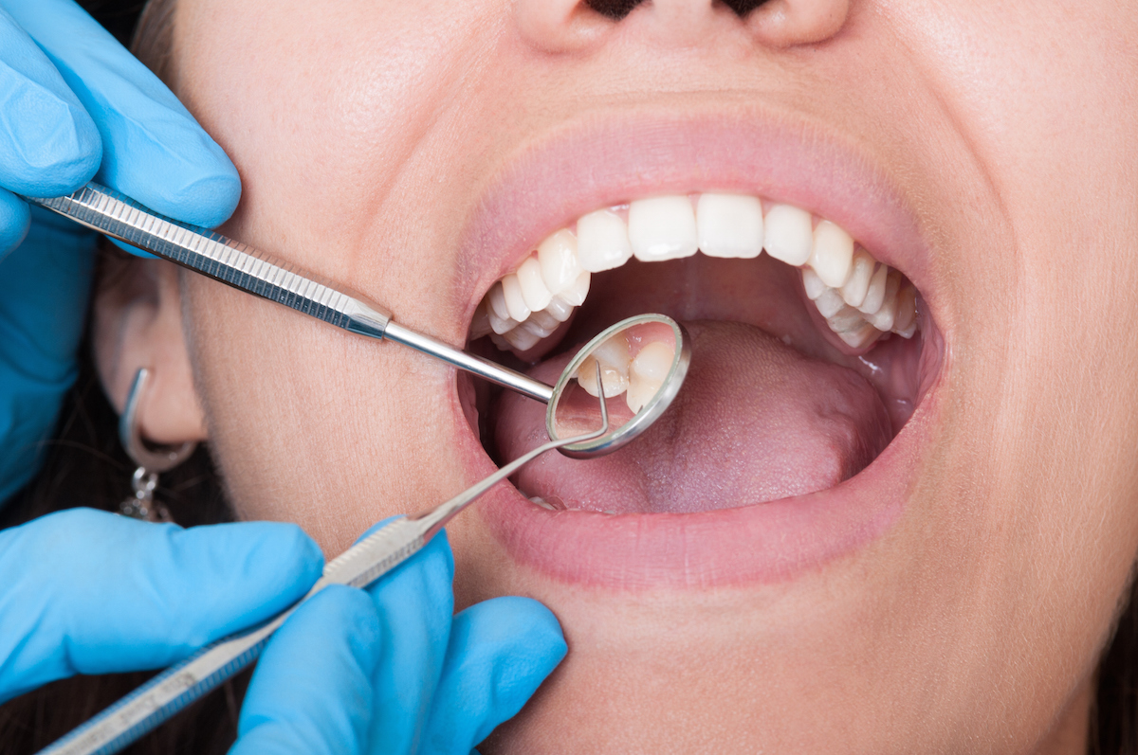
What does OH say about the tongue function?
Terrible, hard to remove plaque
Bridge of calculus lower anterior
Food debris around molars
Cervical decay
They mouth breathe
They have a restricted tongue that can’t reach all around to find leftover food debris
They have a tongue thrust or reverse swallow leading to acid reflux
All of the above

Slide 16
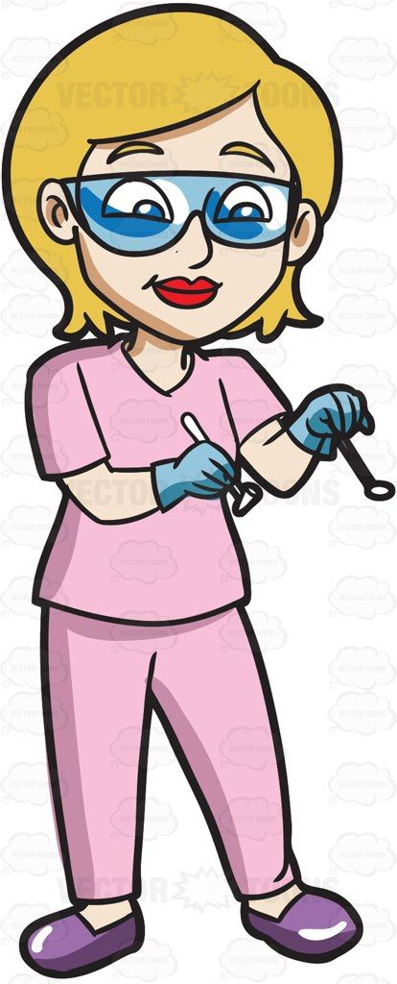
Impacts of OMDs on oral health:
Mouth breathing
drying the plaque/debris on the teeth
inflamed gingival tissues
inflamed throat tissues
Limited tongue mobility to clean the debris from the teeth between brushing
Low tongue posture displaces the jaw
Leads to more clenching
Leads to more grinding
Leads to more wear and cracking of the teeth
Leads to more narrowing of the dental arches/crowded teeth

Slide 17
Malocclusion
Why do they have crowding?
Why do they have an open bite?
Why do they have narrow dental arches?
Why have they had ortho relapse?
Because they have
POOR Oral Rest Posture

Slide 18
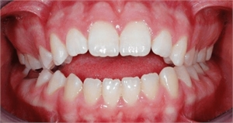
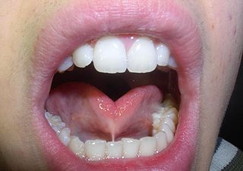
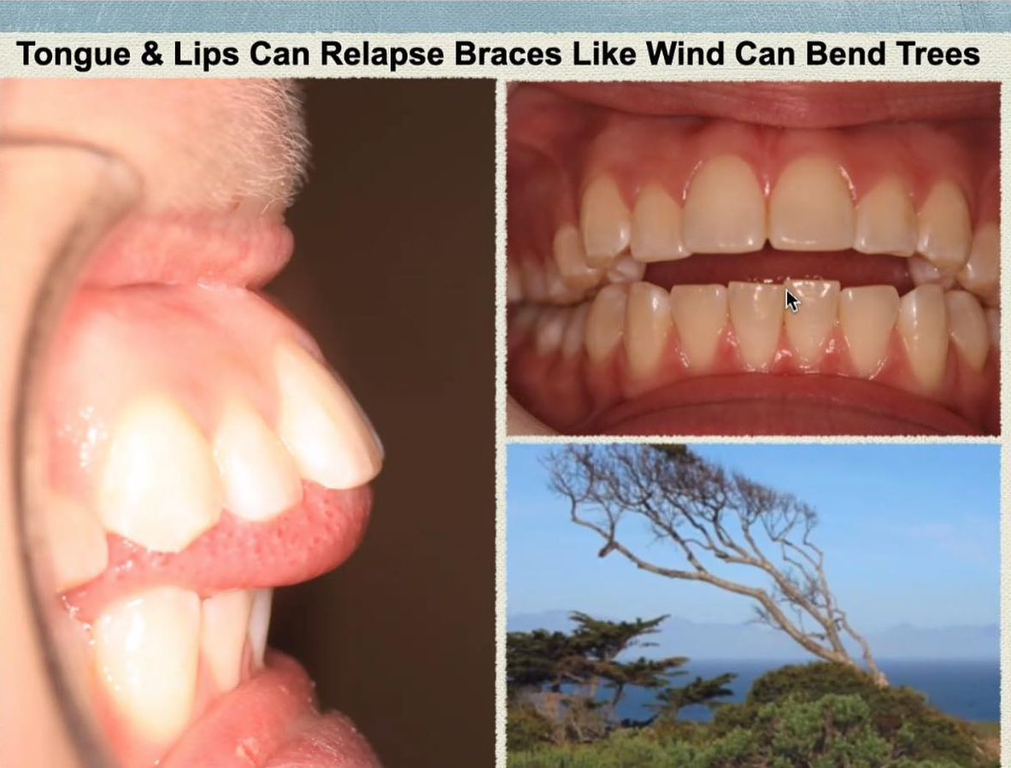
WHY OPEN BITE???
From the tongue resting against the teeth or interdentally
Lack of tongue and airway space
Lack of proper function or mobility (tongue tie)
Could be Both
These limit proper oral rest posture!
By: Felix Liao

Slide 19
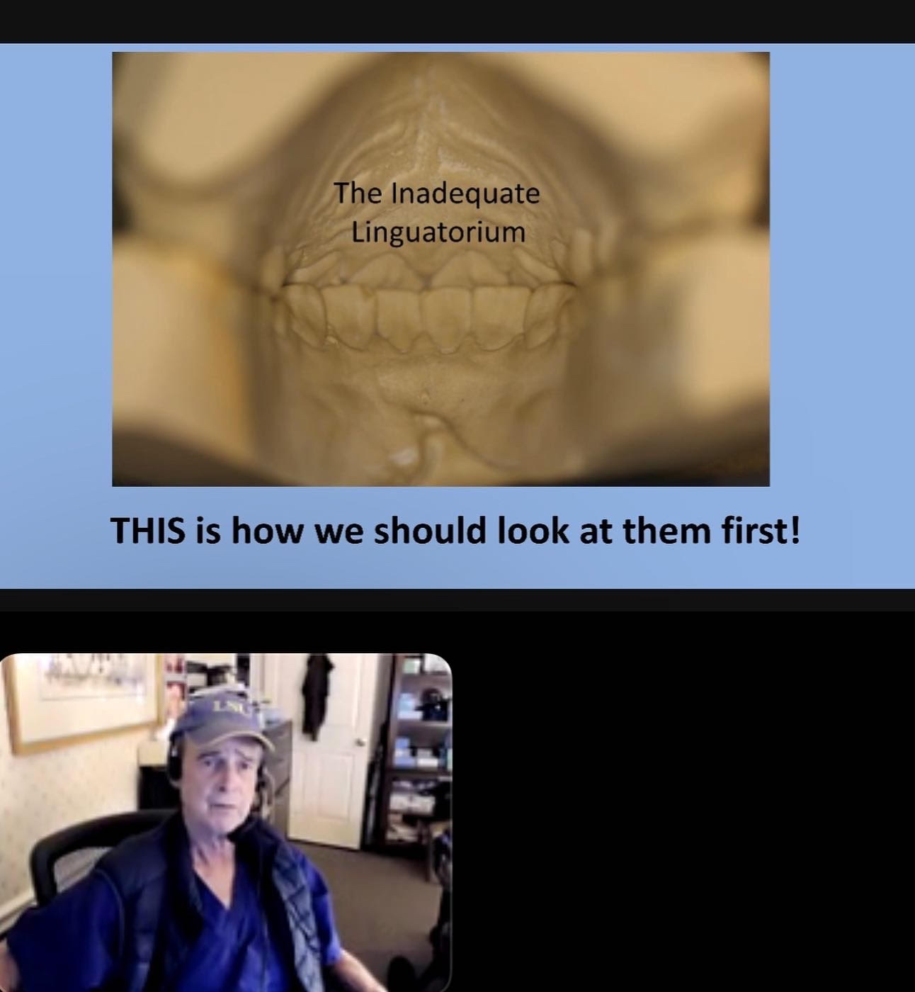
Tongue space!
Have them do a tongue click; then freeze and hold what’s called a lingual palatal suction (LPS)
Does their tongue have adequate space?
Does it overflow onto the occlusal surfaces and by how much… Mild? Moderate? Severe?
Dr. Colquitt, DDS
Airway Circle 1/12/2023

Slide 20
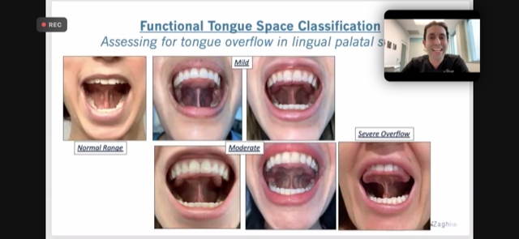
Thank you Dr. Zaghi
&
The Breathe Institute

Slide 21
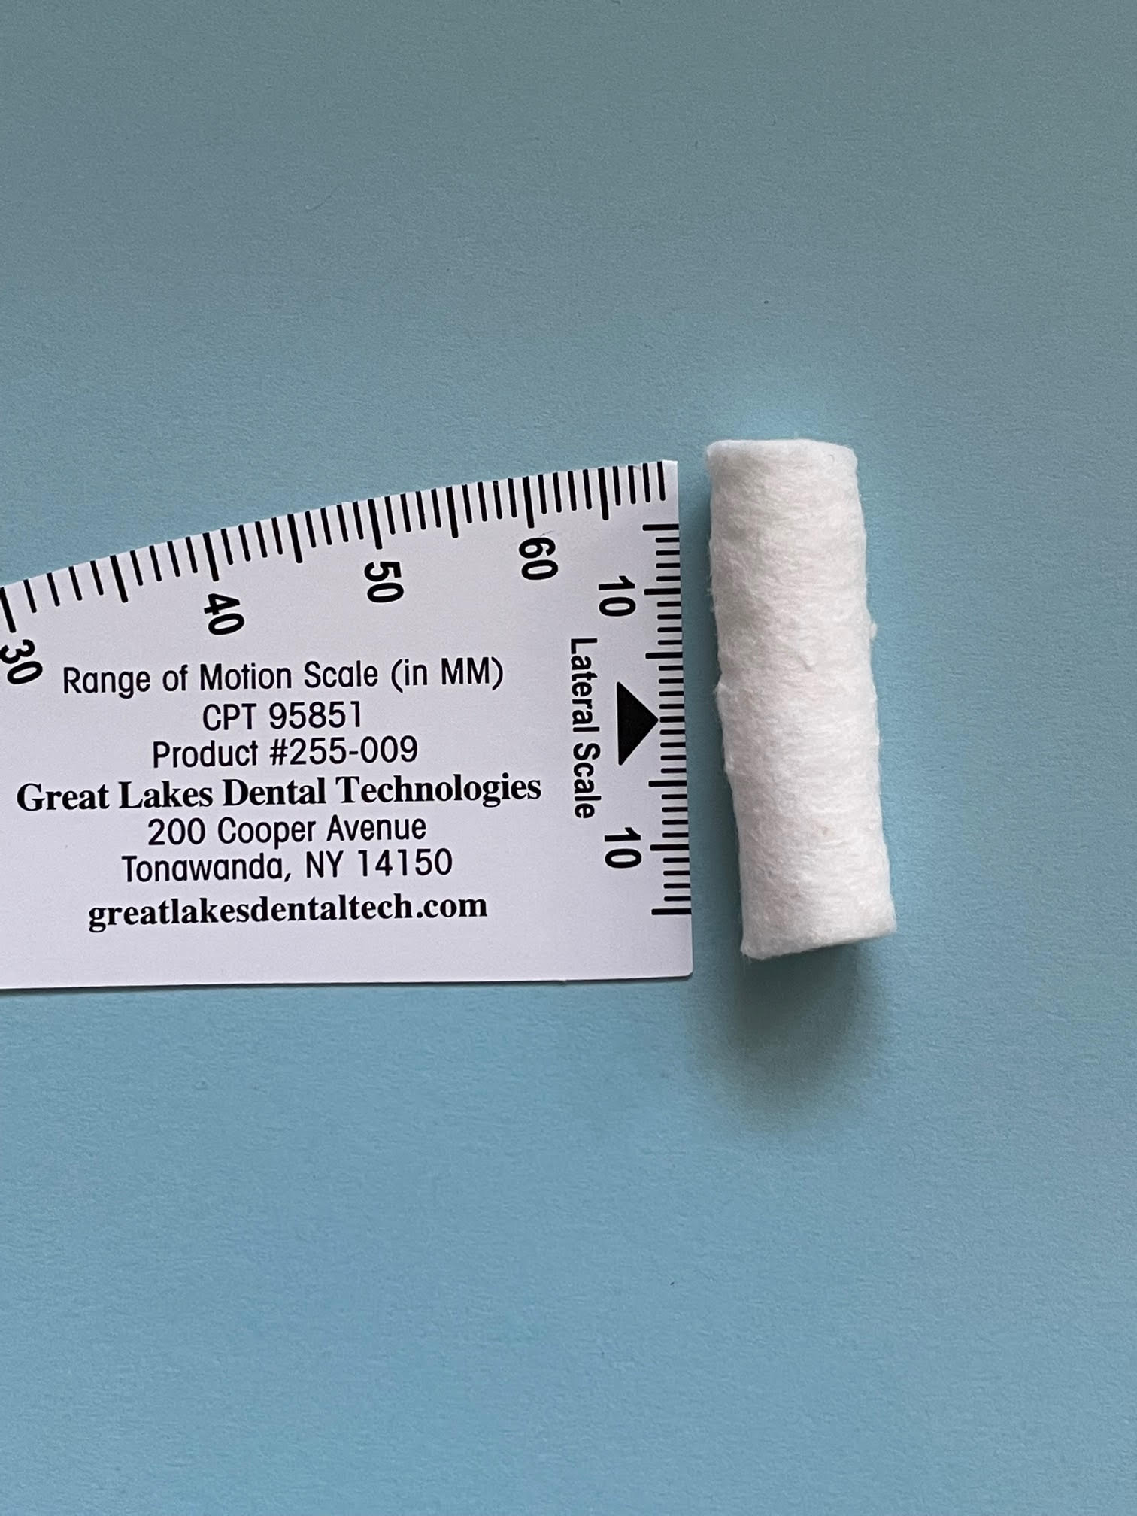
Intermolar width:
Is there an ideal palate width? NO
38-40mm is great according to The Breathe Institute
But really 36mm for women and 40 for men
Depends on other things as well so I don’t just go off measurements:
Tongue size
Palate height
Size of the mandible
Occlusion
Face height/shape
According to Dr. Ben Miraglia with Airway Health Solutions:
Age 8 = 35mm+
Age 12 = 40mm+
Age 18+ = 45mm+
*** Main rule of thumb is in order to maintain that width – you need to keep your tongue in your palate with nasal breathing all day and all night.

Slide 22
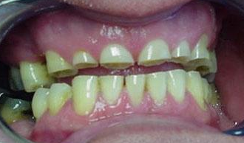

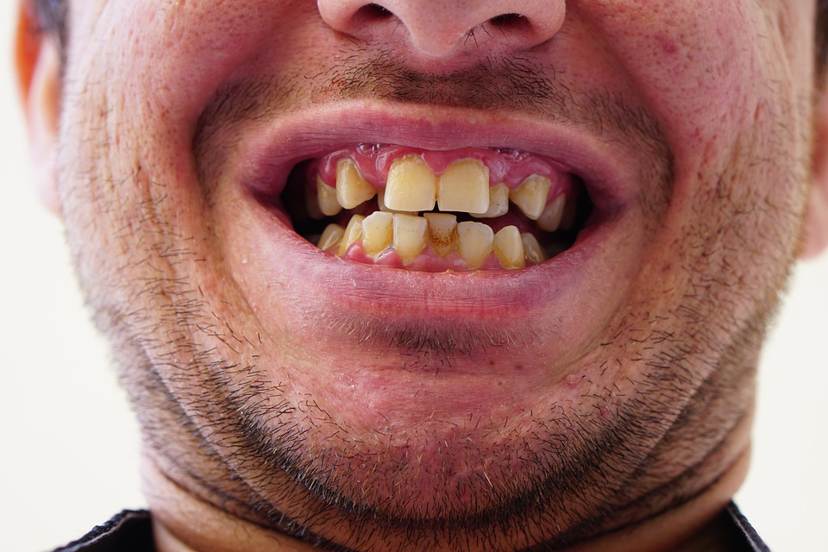
Tooth grinding/wear
NARROW
MAXILLA

Slide 23
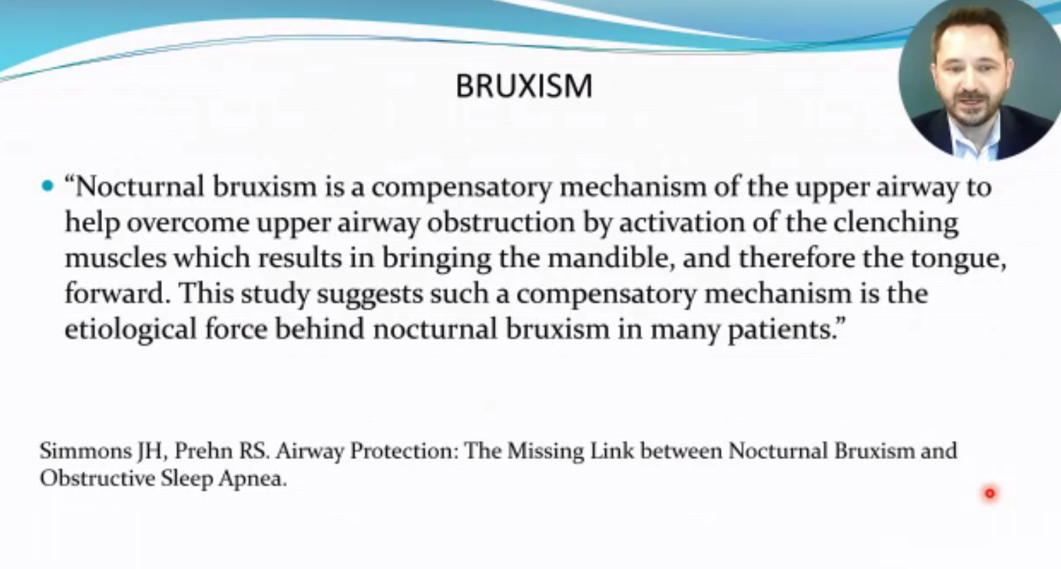

Slide 24
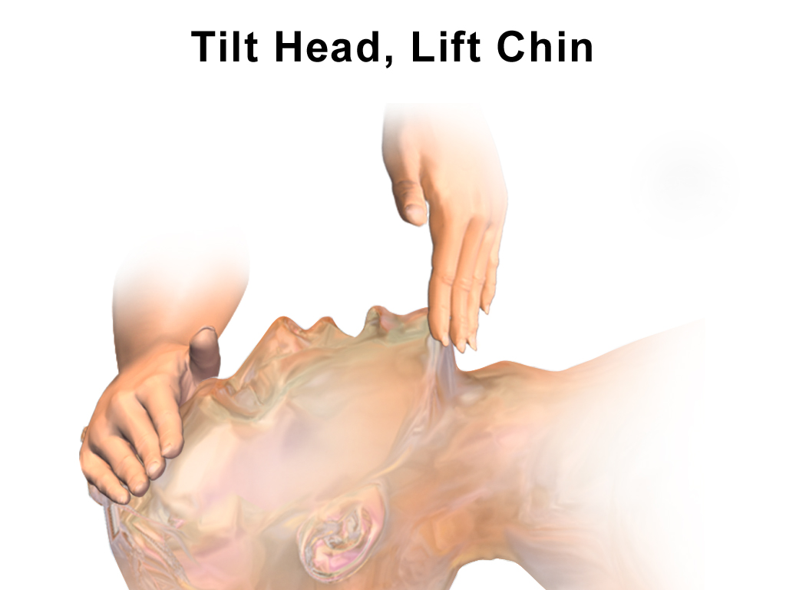
CPR: Mandible/Jaw thrust = getting the tongue out of the way!!
Just like grinding…
Just like a mandibular advancement appliance (MAD)

Slide 25
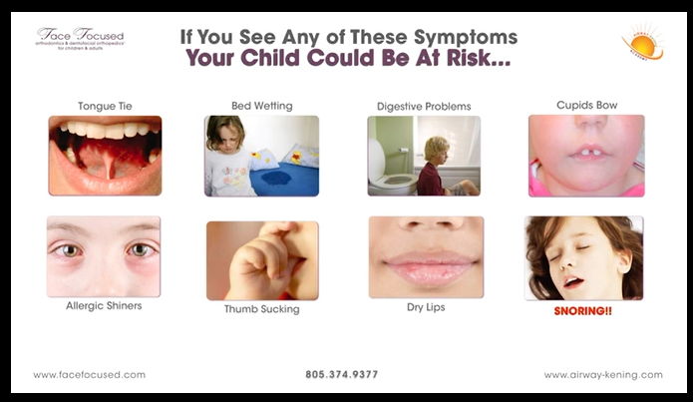
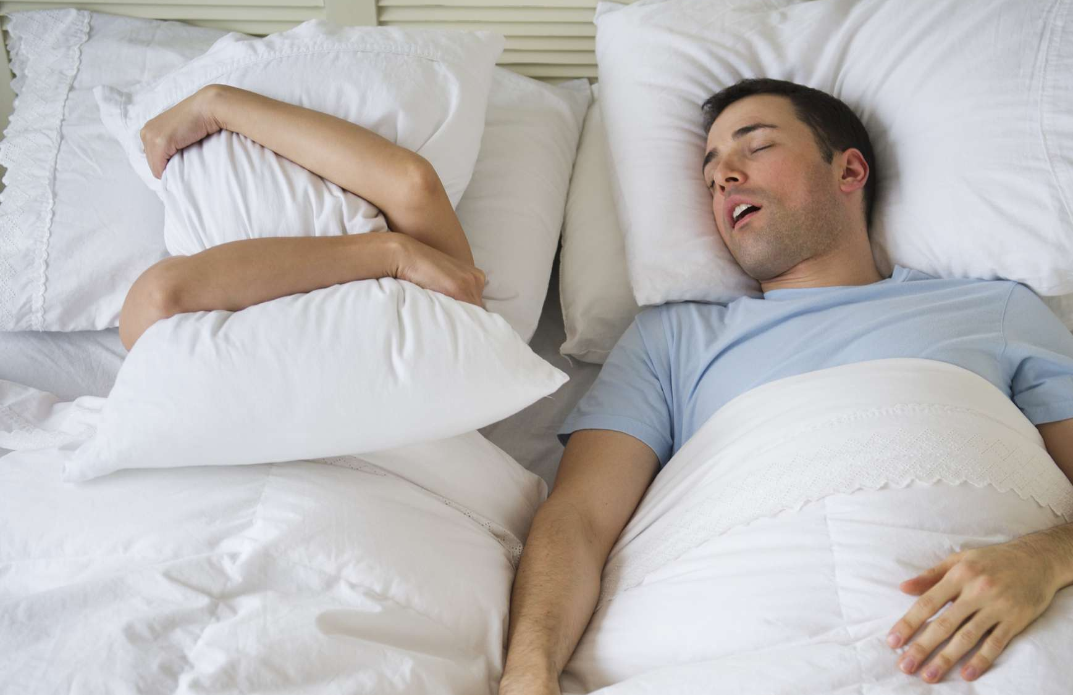
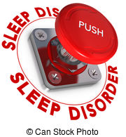
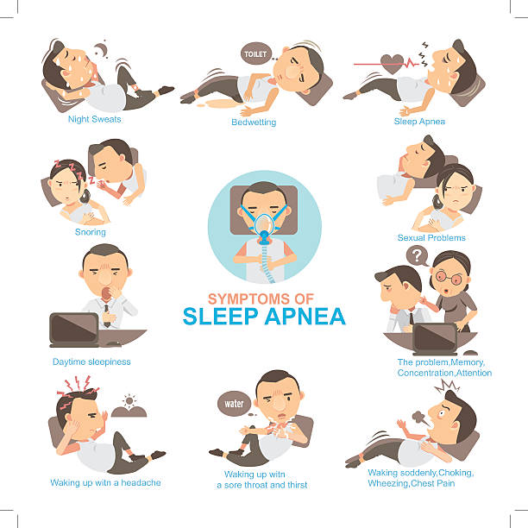
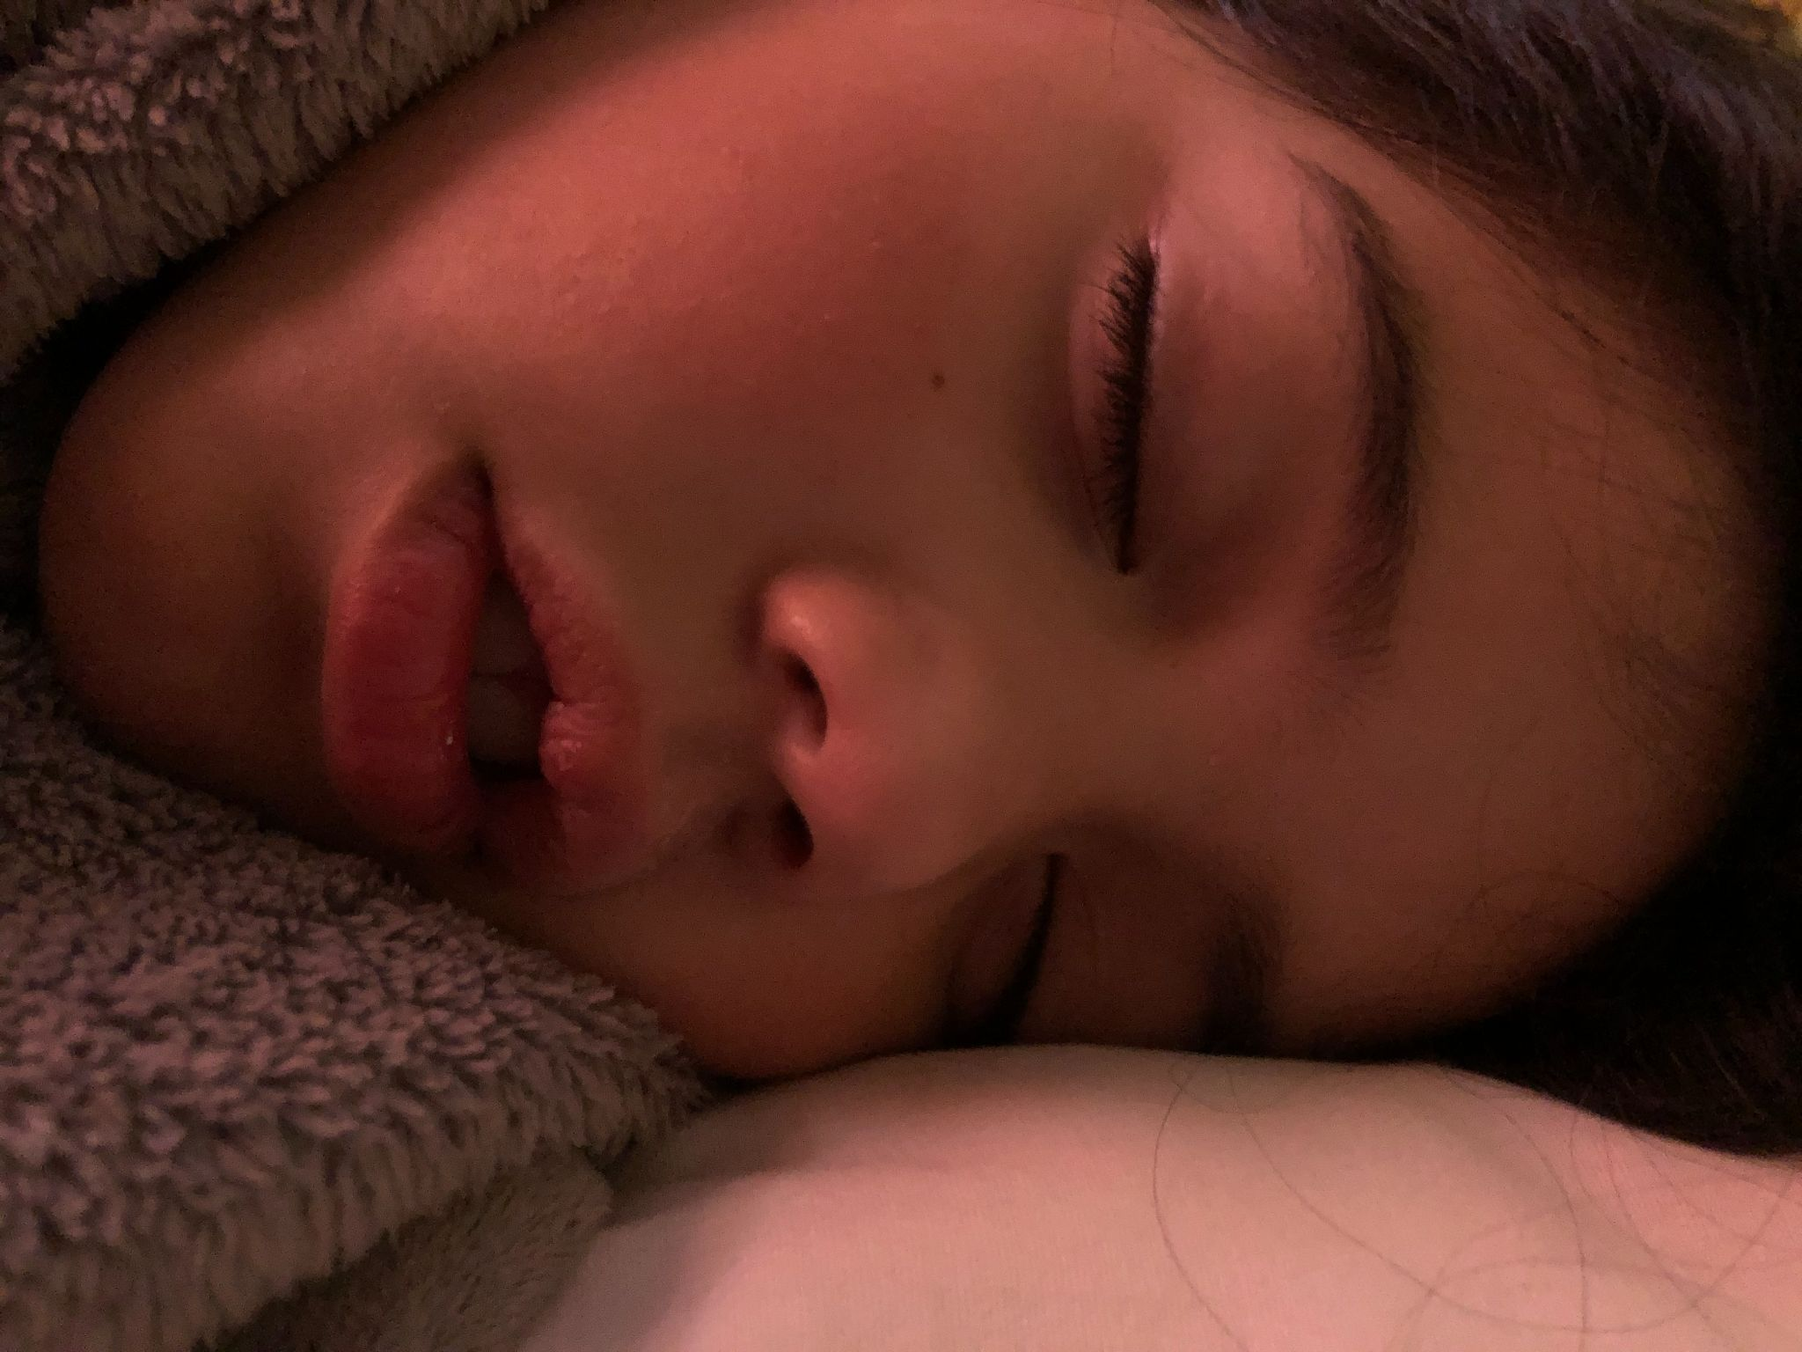
We don’t grow out of airway and sleep disorders…
We grow into them!

Slide 26
How do we help them?
By creating
The Airway Team™

Slide 27
What's the order of referrals and treatment?
Where do we start?
Can they nose breathe?
What are their symptoms?
What are their chief complaints?
Have they had a sleep study?
Do they have adequate tooth, tongue, and airway space?
Do they have obvious oral ties limiting lip closure and tongue posture?
Do they have proper oral rest posture?

Slide 28
My order of operations depends on a lot of things…
but most commonly:
Nasal Breathing
Sleep Study
Tongue, tooth, and airway space - Expand when needed
Work on proper oral rest posture: OMT
Release Oral Ties (if needed)
Continue to work on Oral Function
Sleep Study
** Bodywork is encouraged throughout

Slide 29
Quick Overview:

Slide 30
TEAMWORK
COLLABORATION
Who else is on this team?
What order do we do things in?
Are there enlarged tonsils? Yes
Are they obvious mouth breathers? Yes
Is it uncomfortable or constricting to nose breathe? Yes
o #1 = ENT - rule out airway barriers
Is there a question of needing expansion? Small, narrow, thumb print palate, crowded teeth, limited tongue space: Yes
o #2 = consult for expansion
Is there obvious mouth breathing? Obvious tongue thrust? Obvious tongue or lip tie? TMJ concerns? Yes
o #3 = Myofunctional therapy
I always encourage bodywork with a provider that specializes in oral ties and cranial growth. However, not all will be able to do all the things. But it is important to consider the posture, central nervous system, and fascia that is connected to that person with an airway concern.
Dental professionals
IBCLC (lactation consultant)
  Under age 12 months
Myofunctional therapist (either RDH or SLP that specializes in OMT)
  SLP - those with speech and/or feeding concerns ages 0+
  RDH - those that don’t have feeding and speech needs ages 5+
Ear/Nose/Throat doctor = ENT
Physician, Sleep MD
Bodywork professional = chiropractor, osteopathic doctor, cranial sacral therapist, physical therapist

Slide 31
The Maxilla = the nasal cavity and the upper jaw
Expand it and impact the upper airway

Slide 32
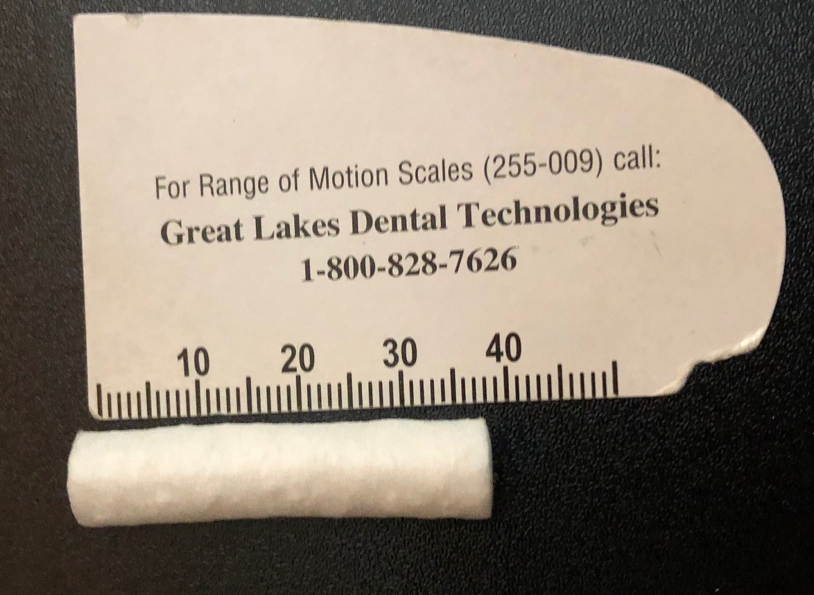
Cotton Roll Ruler
Use a cotton roll to see if it fits in their palate from 1st molar to 1st molar - gingival margin to gingival margin (not the cusps because the teeth could be tipped/angled)
According to Dr. Ben Miraglia with Airway Health Solutions:
Age 8 = 35mm+
Age 12 = 40mm+
Age 18+ = 45mm+

Slide 33
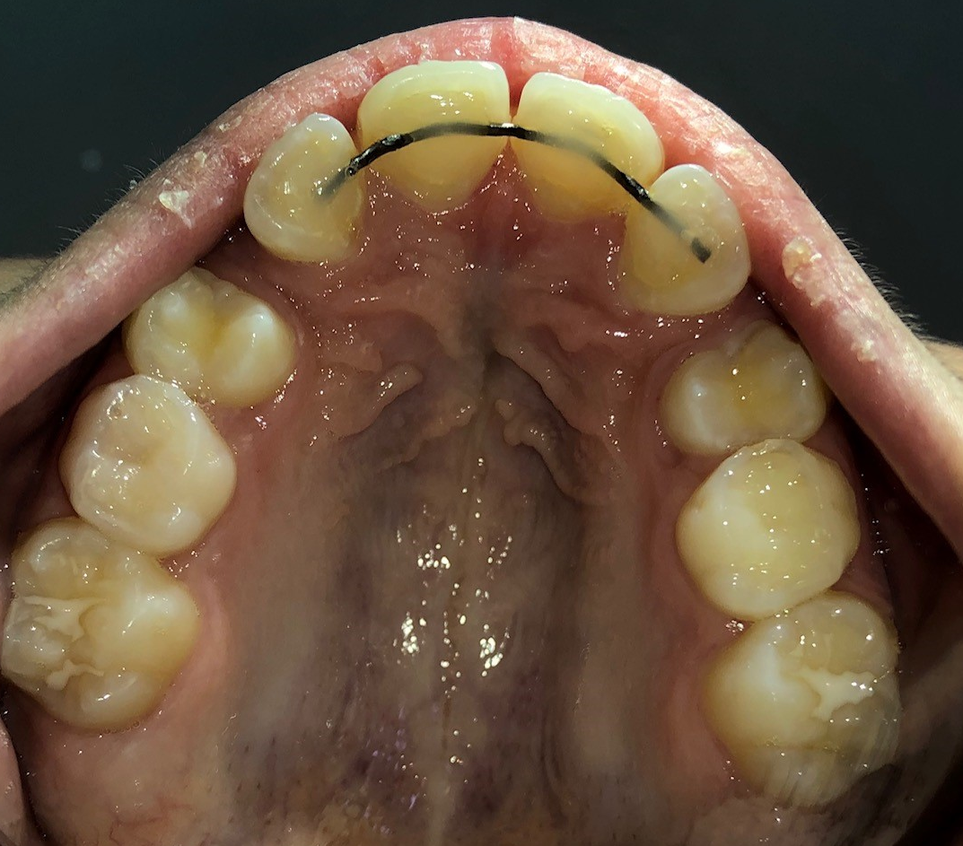
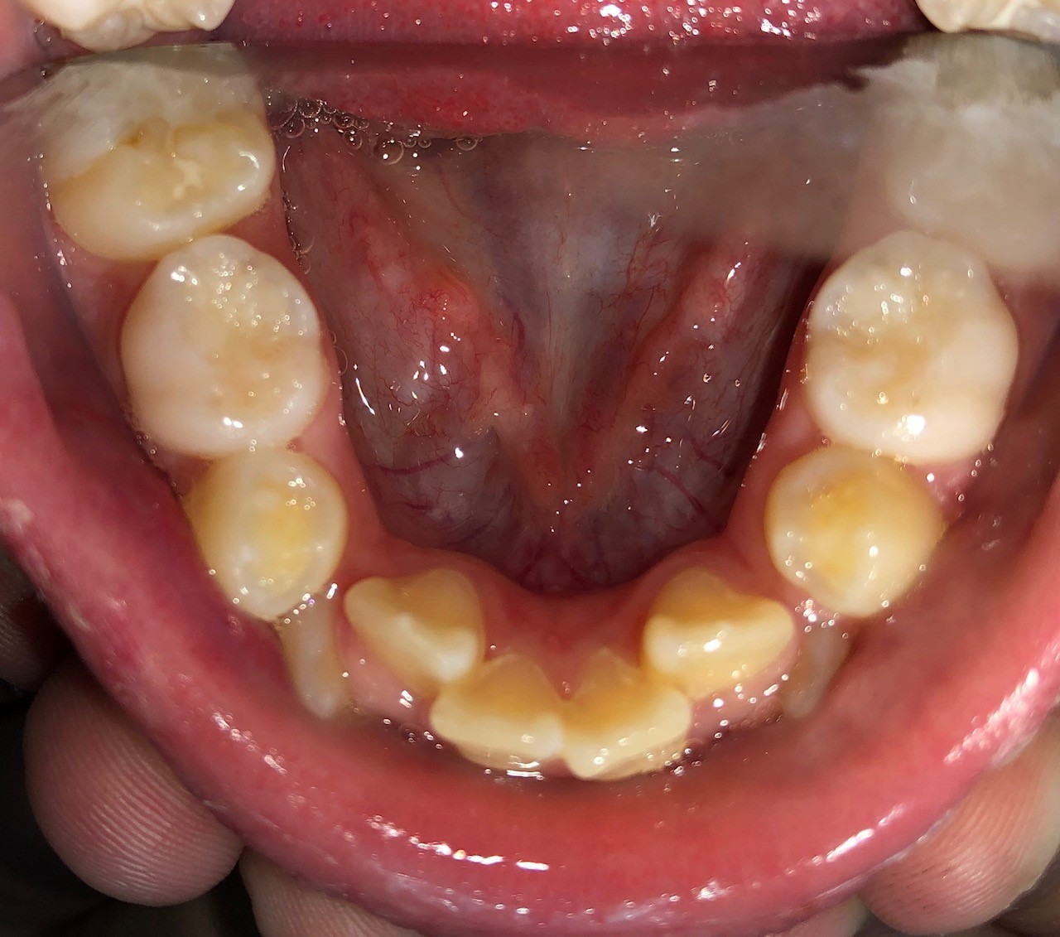
My Passion
My WHY
Why did I become a myofunctional therapist?

Slide 34
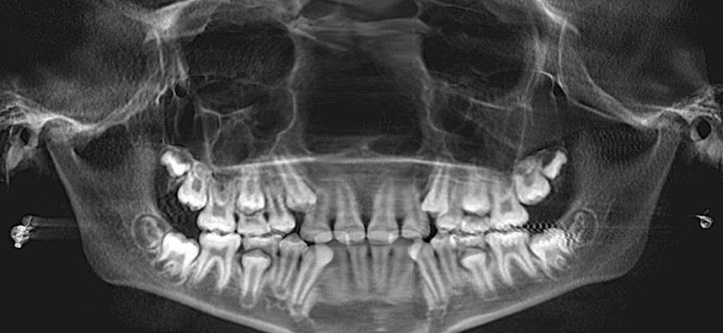
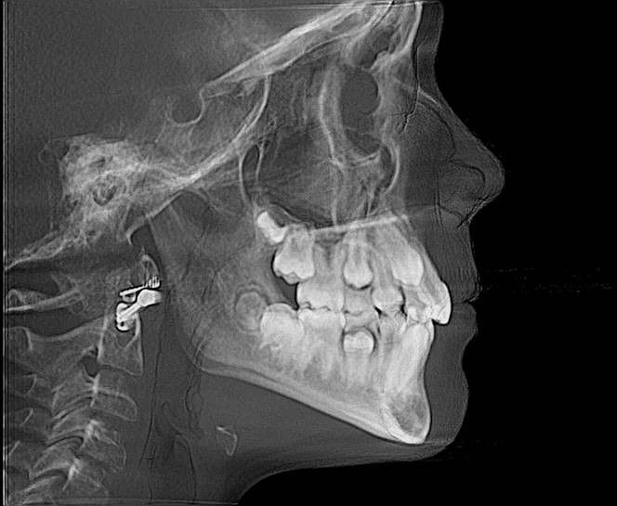
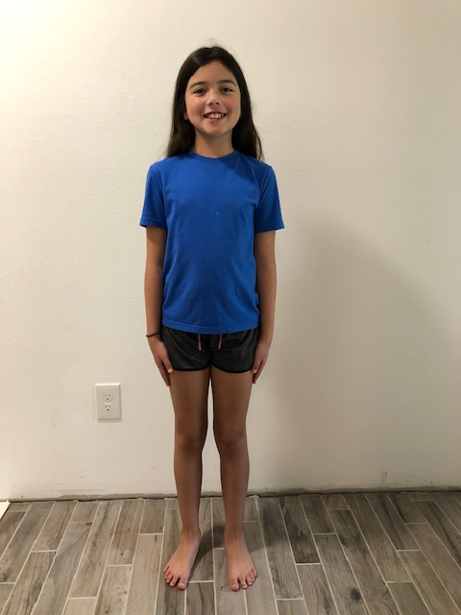
My 1st myo case in 2020
Age: 10, Female, DOB: 8/26/2009
Breastmilk fed until 6 months - but via a bottle because she struggled to actually nurse.
Severe colic as an infant
Pacifier use and sippy cups past age 2; no history of finger sucking or other oral habits
Always in the lower part of her growth curve with poor weight gain
History T/A removed and ear tubes placed at age 6 (after chronic ear infections every 3-4 weeks for over 13 months.
TMJ: tight and sore with opening wide
Eating: reports likes softer foods; however, no aversions to meat textures.
Visible tongue thrust upon swallowing
No speech concerns. Had over 75 words in her vocabulary at age 1.
Walked at age 13 months
Straight A student and in the gifted program since kinder
History of nightmares, night-terrors, and high anxiety since infancy

Slide 35
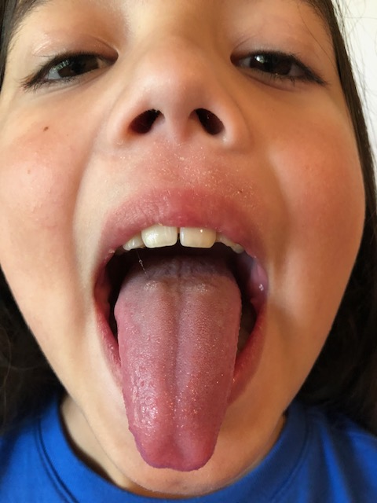
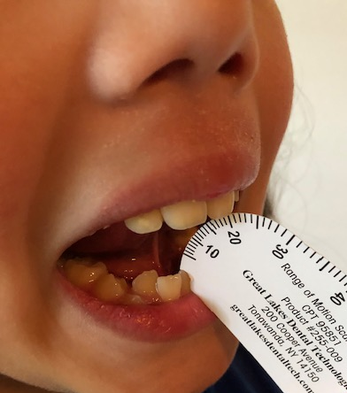
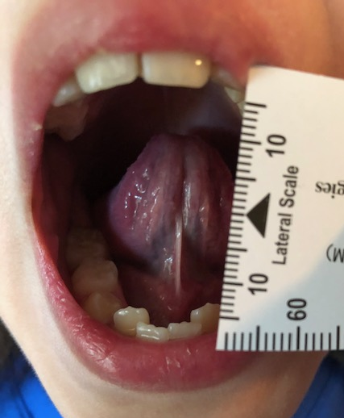
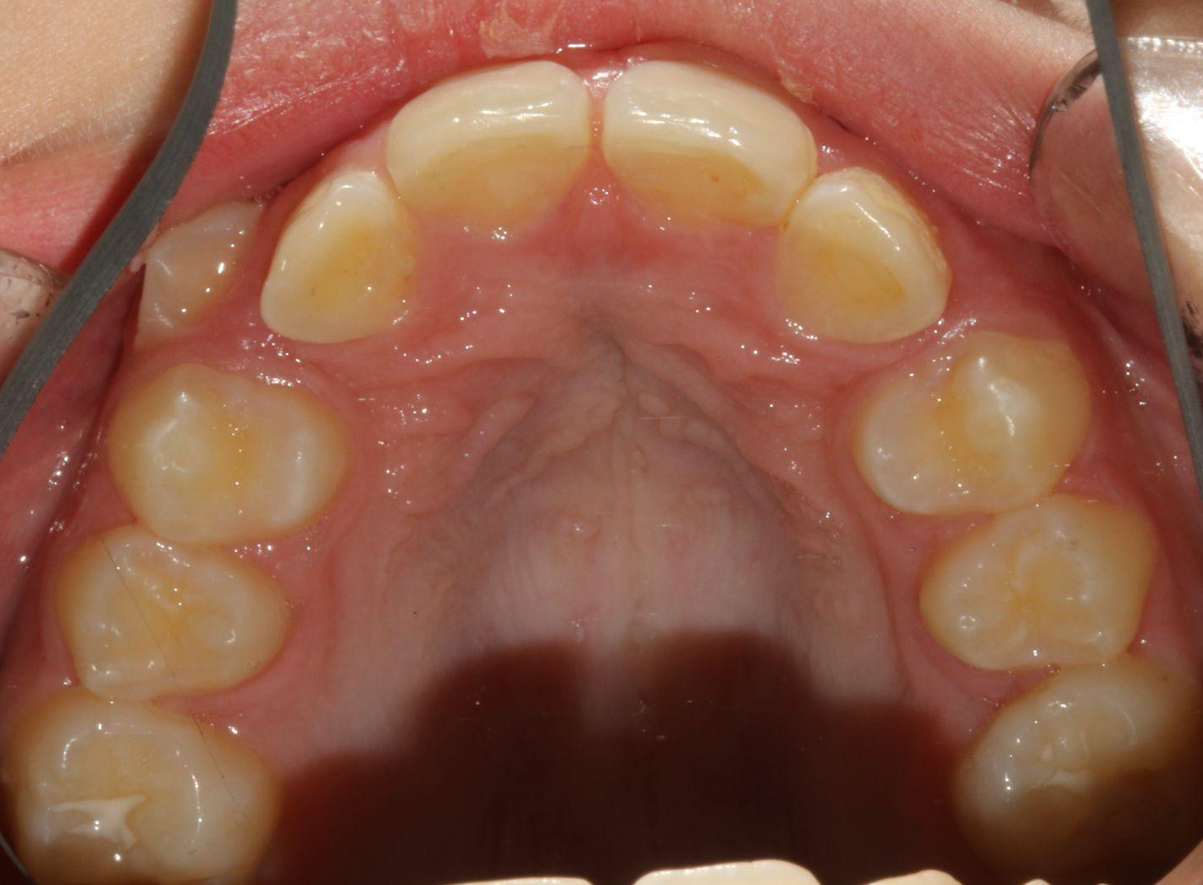
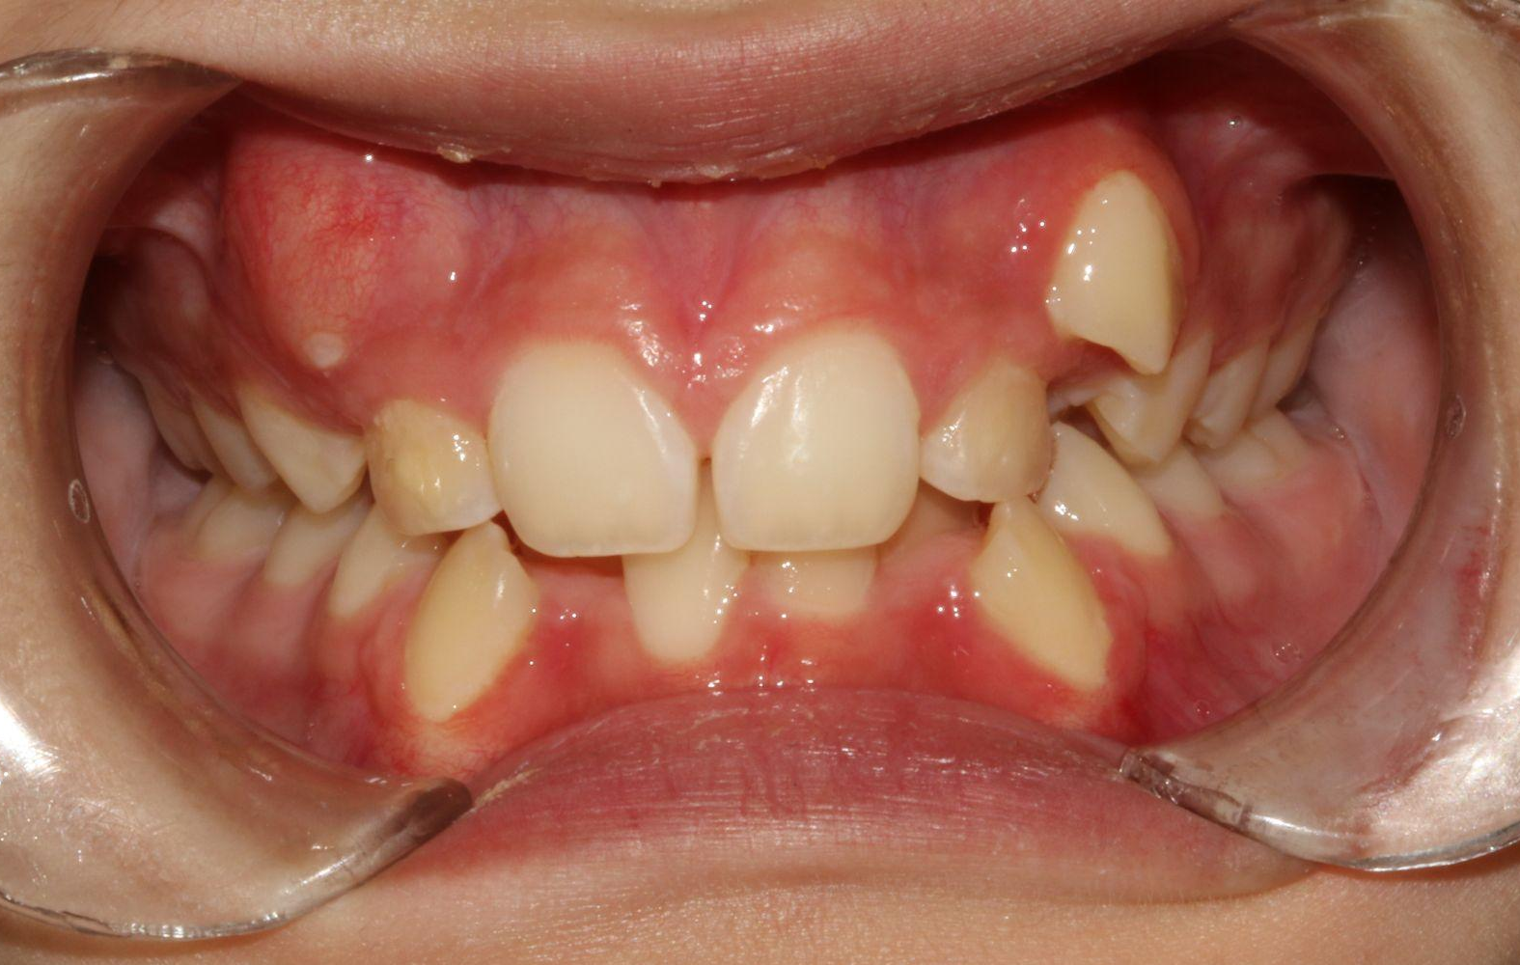
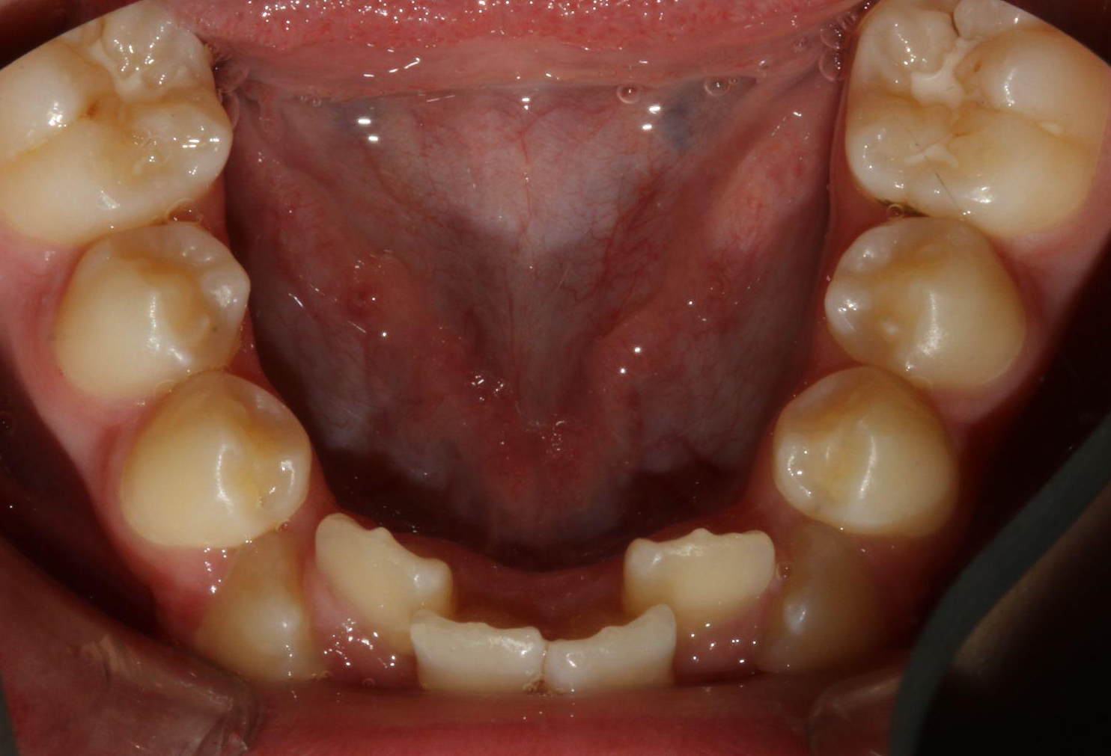
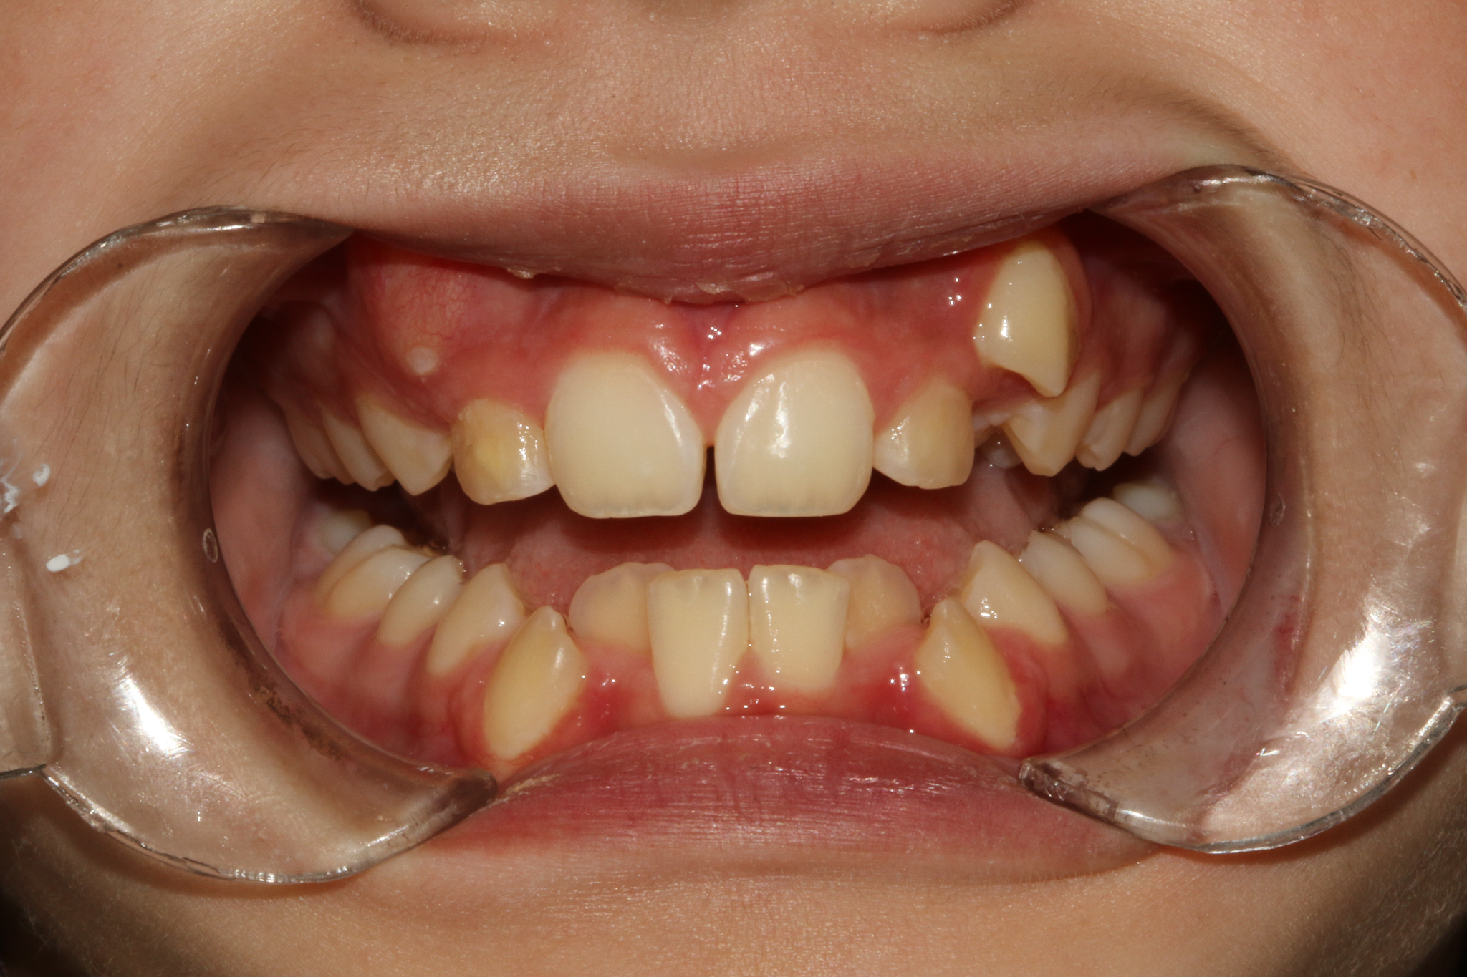
Randi:
Age: 10, Female
DOB: 8/26/2009
Rapid Palatal Expansion at age 7-8 and a few anterior brackets at age 9.
Maxillary arch = 29-30mm wide; Class I occlusion with crowding and mixed dentition
Upper lip curled inward with mentalis strain.
Resting posture with lips apart about 8mm
Mouth breather
Mallampati class nearly grade 4
Ortho now recommends extraction of 4 premolars due to lack of space
ROM: 40 TIP: 19 LPS: 12
NOT ENOUGH TONGUE, AIRWAY, OR TOOTH SPACE

Slide 36
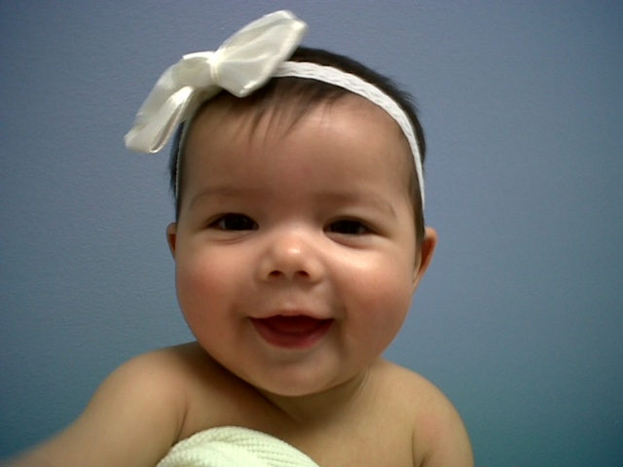
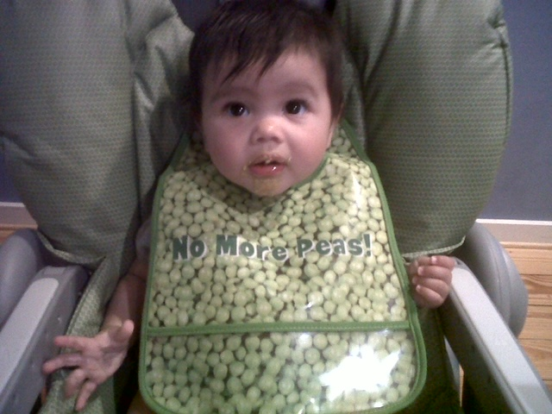
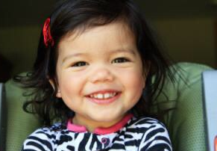
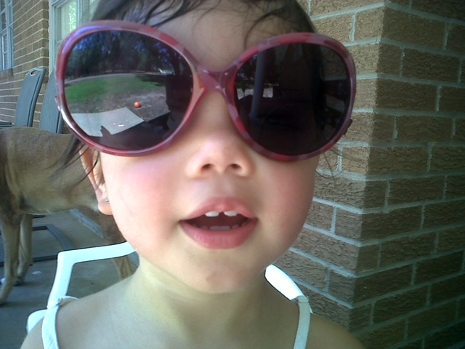
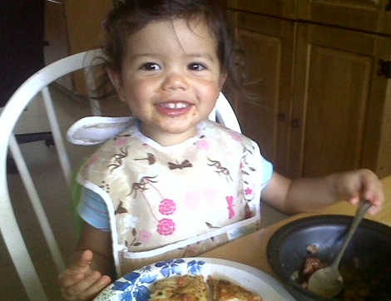
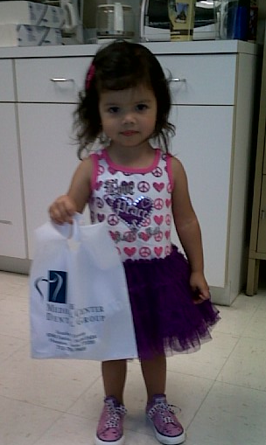
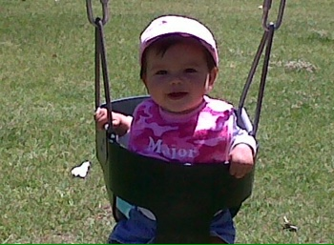
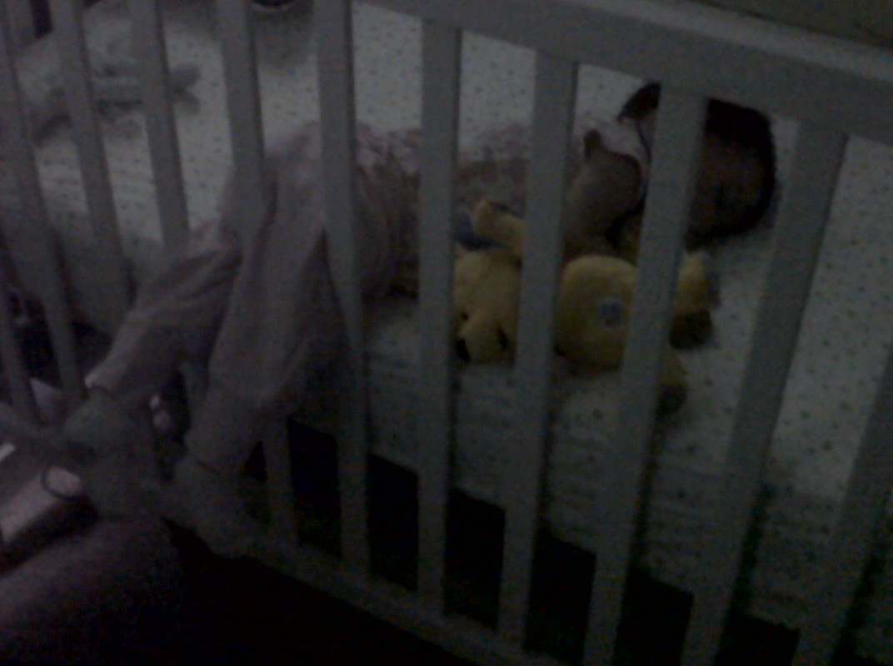
LIPS ALWAYS DRY & APART
ALWAYS MOUTH BREATHING
SUPER CUTE KID
USUALLY SMILING
MESSY EATER
MESSY SLEEPER
HIGHLY ANXIOUS

Slide 37
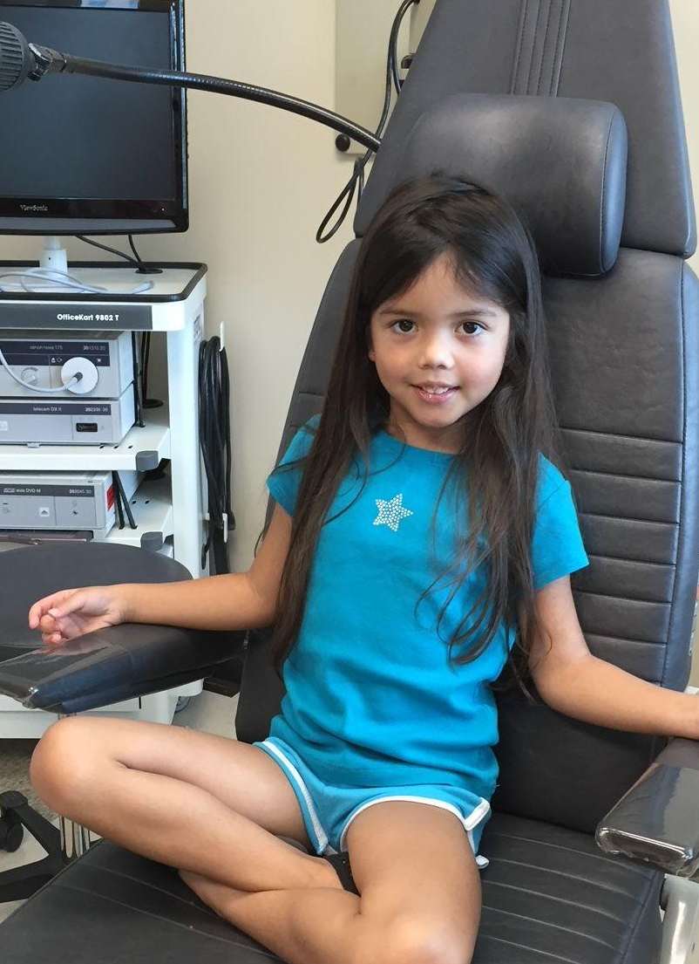


MY DAUGHTER, RANDI - MY WHY!
After tonsils and adenoids were removed and palate expansion… Still mouth breathing, still anxious, still not enough room for her teeth, still not thriving…
What did we miss?
THE FUNCTION!!!
Our bodies don’t just adapt to surgery. The function has to be addressed and relearned.
Before tonsils and adenoids were removed… Dark circles under the eyes, turned up tip of nose, mouth always open (mouth breathing), dry crusty nose and lips, deep set eyes, very small for her age, bed wetting past the age of 5, nightmares, highly anxious.
ALL SIGNS OF SLEEP
DISORDERED
BREATHING

Slide 38

What can we do besides extract and retract?

Slide 39







The plan and the team… Dr. John Karotkin and Dr. Todd Scheyer
All planned and scheduled between Perio Health Professionals and Advance Orthodontics
July 2022
Oral sedation and nitrous
MSE = maxillary skeletal expansion
4 screws anchored into the palate
Irrigating with Stellalife in a monoject syringe
Cranking her appliance as directed

Slide 40



From July to September:

Slide 41



After we stopped actively expanding her gap started to close…

Slide 42


29-30mm maxilla —--> 39mm maxilla

Slide 43

The plan and the team… Dr. John Karotkin and Dr. Todd Scheyer
6/6/2022
10/19/2022

Slide 44
PROGRESS PHOTOS… from 6/2022 to 6/2023

Slide 45


PROGRESS PHOTOS… from 6/2022 to 6/2023

Slide 46
PROGRESS PHOTOS… from 6/2022 to 6/2023
VAULTED CEILING
Mouth Breather
Sympathetic Nervous System
DOME CEILING
Nose Breather
Parasympathetic Nervous System
NO EXTRACTION AND RETRACTION FOR THIS GIRL

Slide 47
Let’s go through the check list:
ENT
Expansion for tongue, airway, and tooth space
Oral Rest Posture & Tongue function
Body work
Release oral ties (if needed)

Slide 48





6/3/23 ORAL TIES
Measurements before the release of ties:
ROM:39mm
TIP: 32mm
LPS: 29mm
Max width: 39mm
Number of ties released: 5
Upper and lower labials, UR and UL buccal, lingual.
Released by Dr. Rachel Garrett & Dr. Chris Tran
Sutures placed under the tongue
Stellalife used for post op discomfort, swelling, and healing
** sponsored by Stellalife and Light Scalpel Hosted by Dr. Justin Seaman

Slide 49



Tethered oral tissue release now that we have created tongue space and tongue function:

Slide 50


teamwork

Slide 51





Cold/soft foods
Ibuprofen 2-3 times the first two days
Stellalife sublingual spray actually worked the best for discomfort
Went home and watched movies
I managed the wound healing with myofunctional therapy like I would with any other patient
Sutures were gone within a week

Slide 52
Before and after…
6/2/23 pre-release:
ROM: 39
TIP: 32
LPS: 29
Floor of the mouth compensation, jaw tension, effort to hold a tongue suction.
7/11/23 5.5 weeks PO:
ROM: 45
TIP: 35
LPS: 34
Less jaw tension
Easier tongue suction

Slide 53


In one school year we went from this… to this!

Slide 54



In one school year we went to this!
long distance track exclusively nasal breathing
Smiling for photos!

Slide 55



Special Thanks!
To Randi’s
“A TEAM”
TEAMWORK MAKES THE DREAM WORK!

Slide 56






Special Thanks!
MY “A TEAM”
TEAMWORK MAKES THE DREAM WORK!

Slide 57
The Maxilla = the nasal cavity and the upper jaw
Expand it and impact the upper airway

Slide 58
FAIREST 6 SCREENER:
Score 2 = mildly increased risk of SDB
Score 4 = moderately increased risk of SDB
Score 6 = severely increased risk of SDB
#7 Look at their oral hygiene

Slide 59
WE ARE SHAPING THE FUTURE!
As an airway health care team - we are literally changing the growth, brain/heart function, mental health, and oral health of the future!
Be bold. Be proud. Be passionate. Be a positive influence.

Slide 60
Susi Quintana, RDH, BS, COM
Certified Orofacial Myologist
Yes, I provide Myofunctional Therapy
But I also help my clients/patients create their “A Team” or The Airway Team™
&
I provide support to the patient and their providers throughout the journey

Slide 61
Myofunctional Method .com
Houston Myofunctional Therapy .com
Katy Myofunctional Therapy .com
Myofunctional Therapy Houston .com
Airway Houston .com
832-452-9441
Social media:
Facebook - Myofunctional Method
Instagram - Houston Myofunctional Therapy

